Slide 1


UT OF LAKSHADWEEP ADMINISTRATION
Presentation on Co-operative Societies

Slide 2
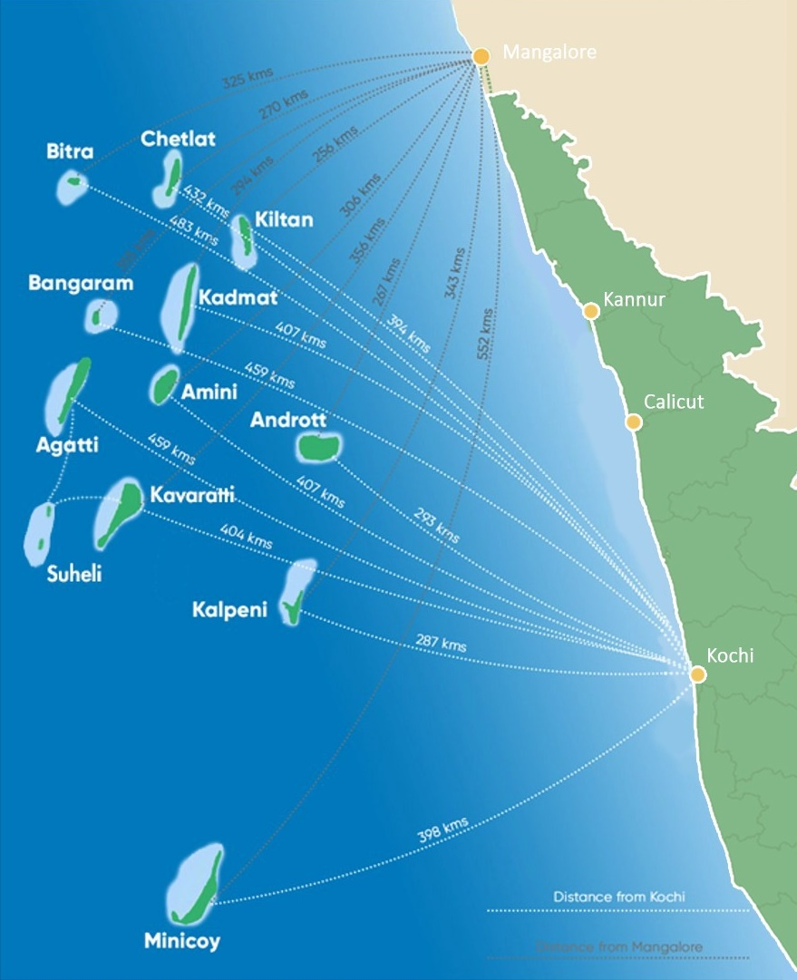
LAKSHADWEEP ISLANDS At a Glance
Karnataka
Distance from W. Coast of Kerala & Karnataka : 220 km – 440 km
Coastline length : 132 km
Population
(2011 Census) : 64,473
Temperature : 23⁰ C – 33⁰ C
Avg. Annual Rainfall : 1,600 mm
Islands, Banks & Reefs : 36
Land area : 32 sq. km
Lagoon area : 4,200 sq. km
Territorial Water area : 20,000 sq. km
EEZ area :4,00,000 sq. km
Kerala

Slide 3
Lakshadweep has 36 islands, banks & reefs & Large water area
10 Inhabited Islands
17 Uninhabited Islands
6 Submerged Banks
S. No. | Island | Area (Sq. km)
1. | Minicoy | 4.80
2. | Kalpeni | 2.79
3. | Androth | 4.90
4. | Agatti | 3.84
5. | Kavaratti | 4.22
6. | Amini | 2.60
7. | Kadmat | 3.20
8. | Kiltan | 2.20
9. | Chetlat | 1.40
10. | Bitra | 0.10
TOTAL |  | 30.05
S. No. | Island | Area (Sq. km)
1. | Viringili | 0.02
2. | Bangaram | 0.58
3. | Cheriyam | 0.46
4. | Kodithala | 0.0027
5. | Tilakkam (i) | 0.02
6. | Tilakkam (ii)
7. | Tilakkam (iii)
8. | Pitti (i) | 0.02
9. | Pitti (ii) | 0.01
10. | Thinakara | 0.42
11. | Parali (i) | 0.02
12. | Parali (ii) | 0.02
13. | Parali (iii) | 0.01
14. | Kalpitti | 0.07
15. | Suheli Valiyakar | 0.29
16. | Suheli Chariyakara | 0.28
17. | Pitti (Bird Island) | 0.01
TOTAL |  | 2.23
S. No. | Submerged Banks | Area (Sq. km)
1. | Bassas De Pedro | 2474.33
2. | Sesostris Bank | 388.53
3. | Cora Divh | 339.45
4. | Amini – Pitti | 155.09
5. | Elikalpeni | 95.91
6. | Investigator Bank | 141.78
TOTAL |  | 3,595.09
3 Coral reefs
S. No. | Coral Reefs | Area (Sq. km)
1. | Baliyapani | 57.46
2. | Cheriyapani | 172.59
3. | Perumul par | 83.02
TOTAL |  | 313.07

Slide 4
BACKGROUND
The Cooperative Movement launched in Lakshadweep in the year 1962.
Initially started for marketing of Agricultural Produce (copra) and extended to distribution of consumer goods and providing cheap credit to the people.
One Apex Cooperative society at the UT Level .
10 Village primary Cooperative Societies in each village island.

Slide 5
LAKSHADWEEP COOPERATIVE MARKETING FEDERATION (LCMF)
Registered under Lakshadweep Cooperative Societies Regulation 1960 and Rules 1961
Members - 81
Established with the twin objectives of
1) Marketing of agricultural related produces of island at affordable prices.
2) The procurement and supply of consumers requirement of the islands at the most competitive prices

Slide 6
SALES TURNOVER OF LCMF
Years | Sales Turnover (Rs. In crore)
2017-2018 | 33.34
2018-2019 | 45.07
2019-2020 | 44.74
2020-2021 | 51.62
2021-2022 | 45.61

Slide 7
Structure of LCMF (Apex Society)
Lakshadweep Coop Marketing Federation
Board of Directors consists of
17 Members
A- Class Members -10
One Representative from each ICS&MS
3 Government Nominees
B - Class Members - 2 Representatives from other types of Societies
Managing Director of LCMF
C- Class Members -1
Representative from individual members

Slide 8
VILLAGE LEVEL COOPERATIVE SUPPLY & MARKETING SOCIETIES (ICS&MS)
Registered under Cooperative Societies Regulation 1960 and Rules 1961.
10 Primary Cooperative Supply & Marketing Societies situated in the islands are functioning as retailers for distribution of essentials and non-essential commodities to the Members, Administration and general public.
Backbone of the island economy as far as marketing of agriculture produce(Copra) and distribution of essential commodities are concerned.

Slide 9
NUMBER OF MEMBERS AND PAID UP SHARE CAPITAL of ICS&MS
Sl.No. | Name of Societies | Members | Paid up share capital (Rs. In Lakh
1. | Kavaratti | 10,702 | 3.30
2. | Kalpeni | 4,425 | 7.58
3. | Andrott | 7,406 | 3.74
4 | Amini | 10,193 | 6.48
5 | Minicoy | 10,102 | 5.0
6 | Agatti | 8,119 | 3.31
7 | Kadmat | 4,332 | 2.47
8 | Kiltan | 3,586 | 2.37
9 | Chetlat | 3,829 | 1.25
10 | Bitra | 1,39 | 2.24
Total | Total | 62,833 | 37.85

Slide 10
THE SALES TURNOVER IN LAST FIVE YEARS
Sl. No. | Name of Societies | Sales turnover (Rs. In Crore).
 |  | 2017-18 | 2018-19 | 2019-20 | 2020-21 | 2021-22 | Total
1. | Kavaratti | 13.59 | 13.99 | 15.99 | 18.96 | 16.20 | 78.73
2. | Kalpeni | 3.12 | 3.34 | 3.80 | 4.45 | 3.99 | 18.7
3. | Andrott | 7.59 | 10.90 | 10.93 | 11.24 | 8.82 | 49.48
4. | Amini | 4.69 | 5.46 | 5.13 | 5.93 | 5.27 | 26.48
5. | Minicoy | 4.42 | 4.69 | 4.57 | 6.28 | 4.55 | 24.51
6. | Agatti | 6.32 | 9.68 | 8.37 | 7.08 | 6.96 | 38.41
7. | Kadmat | 3.84 | 5.06 | 5.76 | 6.89 | 6.39 | 27.94
8. | Kiltan | 1.93 | 3.57 | 4.02 | 4.40 | 2.9 | 16.82
9. | Chetlat | 1.67 | 2.06 | 2.07 | 2.02 | 1.88 | 9.7
10. | Bitra | 0.57 | 0.52 | 0.69 | 0.97 | 0.74 | 3.49
Total | Total | 47.74 | 59.27 | 61.33 | 68.22 | 57.70 | 294.26

Slide 11
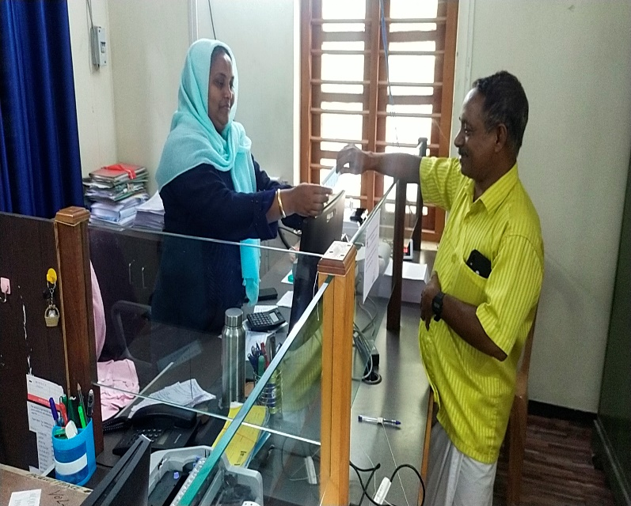
SERVICE COOPERATIVE SOCIETIES
Nine Service Cooperative Societies in Islands.
Provide loans to members for the purpose of purchasing Agricultural produce, house construction and for other purposes.

Slide 12
NUMBER OF MEMBERS AND PAID UP SHARE CAPITAL OF SERVICE COOP. SOCIETIES.
Sl. No. | Name of Society | Members | Paid up share capital (in Lakh)
1. | Kavaratti, Island Service Coop Society. | 2061 | 30.07
2. | Minicoy Island Service Cooperative Society. | 1777 | 8.16
3. | Andrott Island Service Cooperative Society. | 1401 | 7.03
4. | Kalpeni Island Service Cooperative Society. | 1358 | 8.17
5. | Kadmat Island Service Cooperative Society. | 2601 | 3.20
6. | Kiltan Island Service Cooperative Society. | 466 | 7.40
7. | Chetlat Island Service Cooperative Society. | 221 | 1.17
8. | Amini Island Service Cooperative Society. | 899 | 2.74
9. | Agatti Island Service Cooperative Society. | 1476 | 4.09
 | Total | 12260 | 72.07

Slide 13
YEARS | LOAN AMOUNT ISSUED (Rs. In Crore) | AMOUNT RECOVERED. (Rs. In Crore)
2017-2018 | 5.58 | 4.12
2018-2019 | 5.68 | 4.49
2019-2020 | 5.67 | 4.58
2020-2021 | 6.21 | 6.75
2021-2022 | 7.82 | 7.82
Total | 30.93 | 27.76
LOANS ISSUED AND RECOVERED IN LAST FIVE YEARS.

Slide 14
OTHER TYPES OF COOPERATIVE SOCIETIES
SL NO | TYPE OF SOCIETY | NUMBER OF SOCIETIES REGISTERED
1 | FISHERMEN CO OPERATIVE SOCIETIES | 7
2 | LABOUR CONTRACT CO OPERATIVE SOCIETIES | 6
3 | GOVT. EMPLOYEES COOP. STORE & CANTEEN | 6
4 | WOMEN CO OPERATIVE SOCIETIES | 4
5 | STUDENTS CO OPERATIVE SOCIETIES | 4
6 | INDUSTRIAL CO OPERATIVE SOCIETIES | 18
7 | LAKSHADWEEP WATER TRANSPORT CO OPERATIVE SOCIETY | 1
8 | LAKSHADWEEP DEVELOPMENT CO OPERATIVE SOCIETY | 1
Total |  | 47

Slide 15
ACTION UNDER WAY
Accounting system in all Island Cooperative Societies is being digitalized.
GST “Online Billing, Inventory Management and GST enabled Accounting System” has been developed with NIC.

Slide 16
LEGAL REGIME
The Laccadive, Minicoy and Amindivi Islands Cooperative Societies Regulation 1960 is the existing Regulation
It is proposed to repeal the said Regulation.
Many provisions do not fit in to present context for the overall development of cooperative movement.
Proposal for bringing a new “Lakshadweep Co-operative Societies Regulation, 2022” by repealing the existing Regulation.

Slide 17
LEGAL REGIME
Contd…
The new Regulation will give a thrust to the Cooperative sector in Lakshadweep in terms of better Service delivery to citizens through Cooperative Societies.
Promotion of economic activities.
Resolution of disputes.
Safeguarding the interests of the public / members of cooperative societies.
Efficient management of cooperative societies, etc.

Slide 18
NEW REGISTRATION OF SOCIETIES REGULATION
No separate Lakshadweep Registration of Societies Regulation, and Administration has been following the Central Registration of Societies Act 1860.
It is proposed to bring a new Regulation for Registration of Societies, viz Lakshadweep Registration of Societies Regulation, 2022.
Better administrative regime for the Societies in the U.T. of Lakshadweep.
Proposed Regulation will enable better monitoring by the Registrar of Societies.

Slide 19
ACTION ENVISAGED
Approval and implementation of newly drafted Lakshadweep Cooperative Societies Regulation 2022 by repealing the exiting Regulation of 1960.
Approval and Implementation of newly drafted Lakshadweep Registration Societies Regulation 2022.
Providing online Registration of Cooperative Societies.
Setting up of an Audit wing in the Department.
Training and skill development.

Slide 20
Co-operative Society
Thank You

