Slide 1

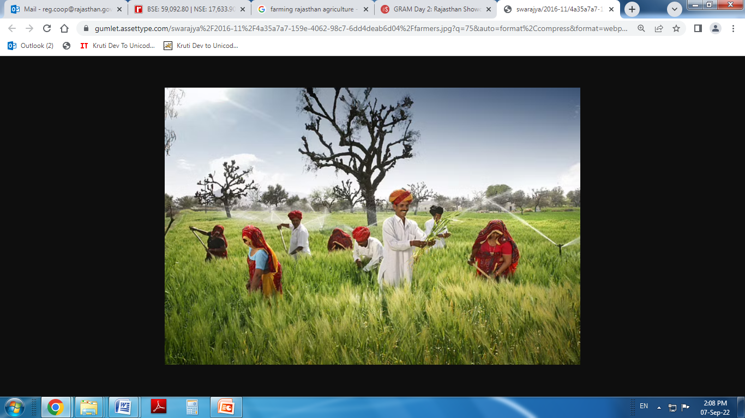

Cooperative Department
Rajasthan
State Cooperation Ministers' Conference
08-09 September 2022
Ministry of Agriculture & Farmers Welfare
Government of India

Slide 2


Cooperatives in Rajasthan : An Overview
Total Registered Societies: 38409
Banking
Dairy
Marketing
7300 PACS
16848 PDCS
7300 PACS
29 CCBs
24 DDCS
274 KVSS
RAJFED
Apex Bank
RCDF
Consumer: 607 Primary Stores; 34 Consumer Wholesale Bhandars; CONFED
Credit Cooperative Societies:700;
Multi-State: 50
Weaver Cooperative Societies:697
Registered Apex Institutions: 22 (Tilam Sangh /RSLDB /SPINFED/ State Cooperative Press/Bunkar Sangh/RSCU etc.)
Primary Coop. Land Development Banks (PLDBs): 36
Urban Cooperative Banks: 36

Slide 3

IT Initiatives
Short-term Loan Distribution
Banking
MSP Procurement
Done through an online portal since July, 2019
Biometric authentication based
CBS platform
Whatsapp banking & mobile banking services started
Completely online from farmers' registration upto payment
Online payment to farmers within 3 days

Slide 4

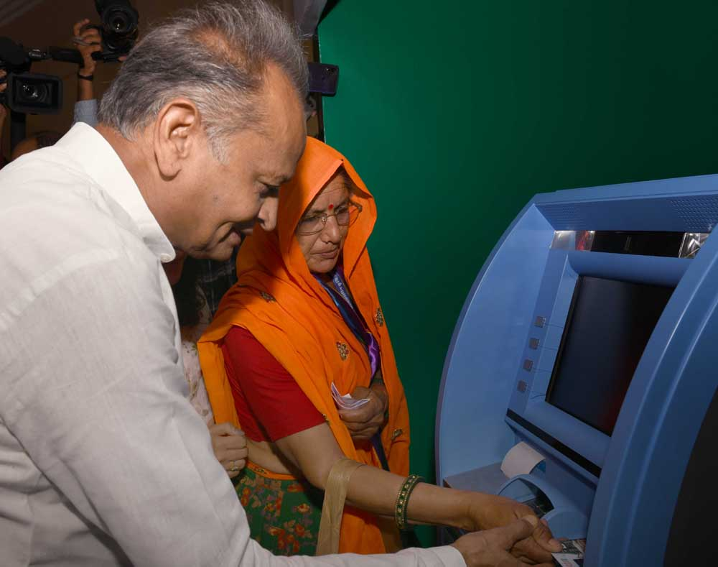
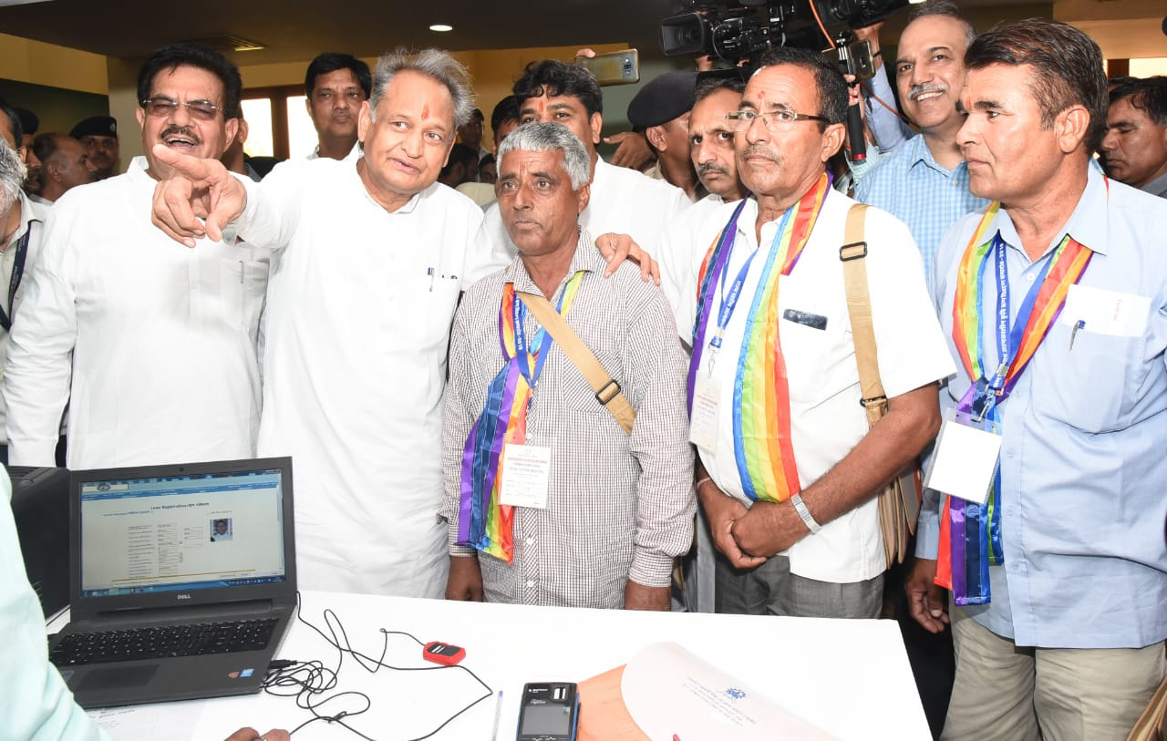
IT Initiatives
Hon'ble CM, Rajasthan inaugurating the online loan distribution portal in July, 2019

Slide 6
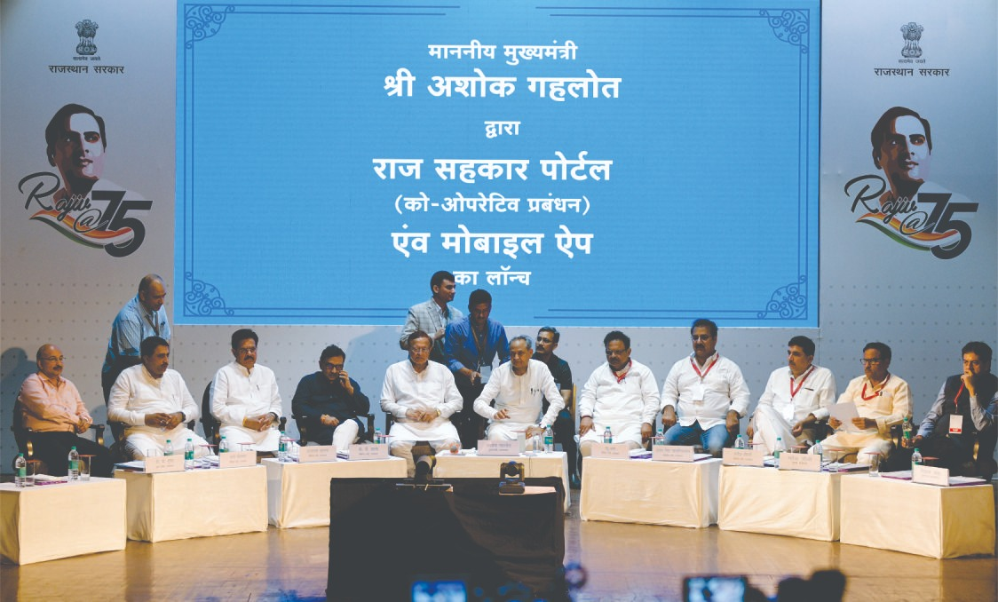
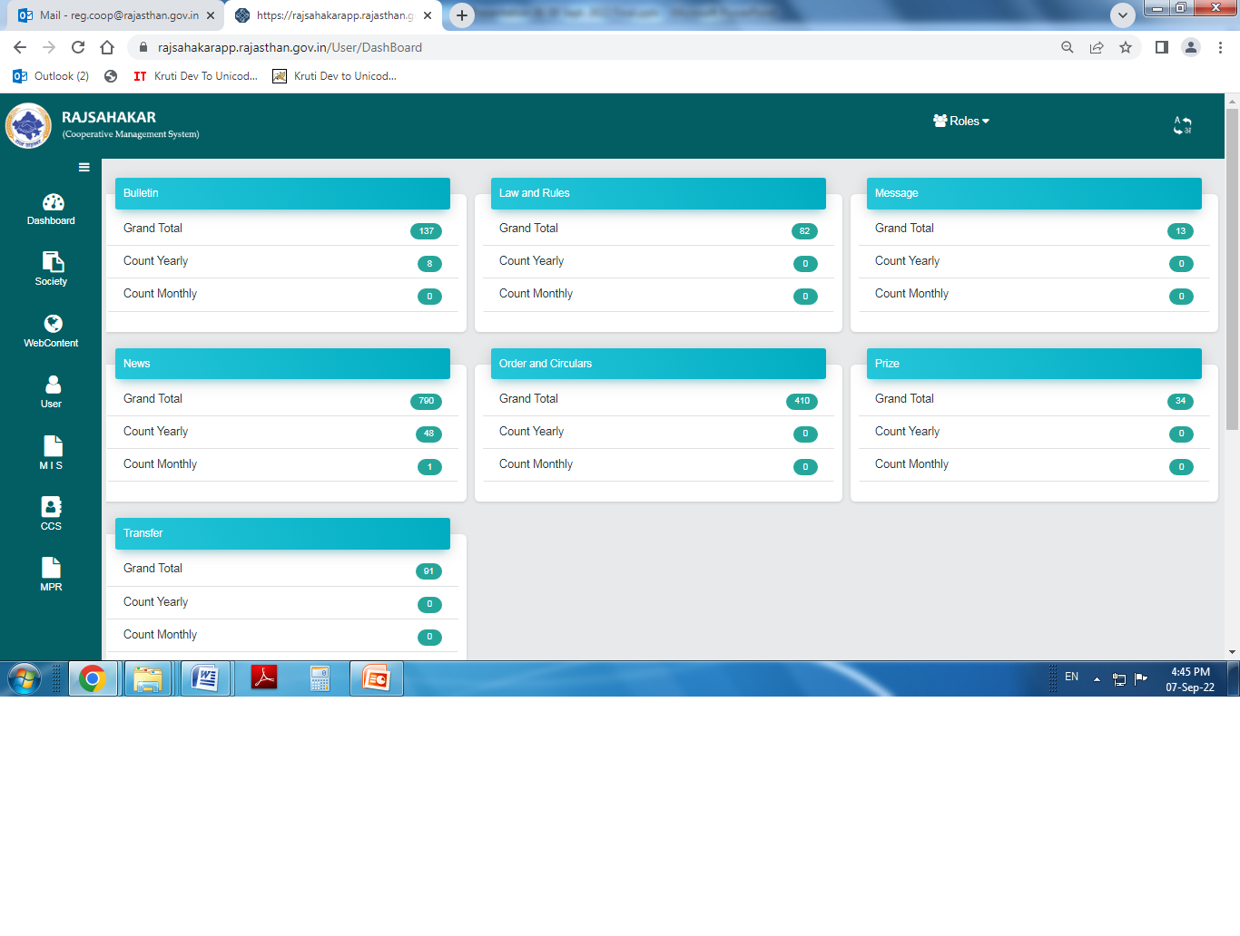
IT Initiatives : Raj-Sahakar App
Online registration of all the societies
Audit allocation of Cooperative Societies and uploading of the audit report
Online monitoring of godowns' construction : geo tagging and photo uploading facility
Module for online application for becoming members of PACS and Primary Dairy Societies
Online profiling of societies
Online complaint registration against frauds of Multi-State/State Credit Cooperative Societies

Slide 7



Important Initiatives and Achievements
Constitution of new PACS
In 2020, the State Govt decided to constitute PACS in all the Gram Panchayats
1159 PACS constituted so far
Election in Cooperative Societies
Elections conducted by independent Election Authority
Elections conducted in 8588 Societies and underway in 4207 Societies.
Recruitment Board for cooperative societies
A separate Recruitment Board constituted in 2017
Recruitment conducted for 880 posts including recruitments for CCBs, Dairy Federations and Marketing and Consumer Societies.

Slide 8



Strengthening the PACS
PACS Computerization -
Total PACS - 7300
Number of PACS to be proposed under GoI scheme for the year 2022-23 - 1730
Custom Hiring Centres under Govt of India Scheme -
(2020-2021 = 152 and 2021-2022 = 285;
Total = 437)
Godowns under State Budget Announcement and RKVY -
(State Budget Announcement = 440 and
RKVY = 600; Total = 1040)

Slide 9
Strengthening the PACS
Initiatives for Business Diversification -
Under the PACS as MSC scheme of NABARD converged with Agri Infrastructure Fund of Government of India and Rajasthan Agro-processing, Agri-business and Agri-export Promotion Policy, 2019, 215 PACS (amount Rs. 47.70 crore) have undertaken projects such as -
Godowns and Warehouses
Post-harvest Processing Units
Sorting and Grading Units
Custom Hiring Centres

Slide 10
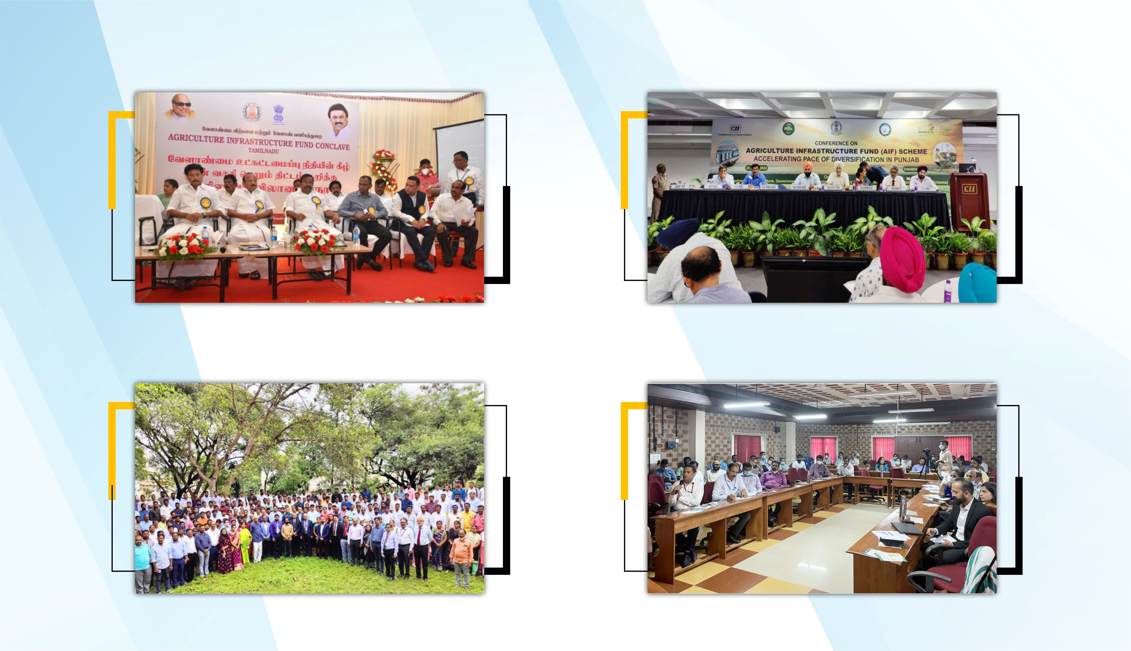
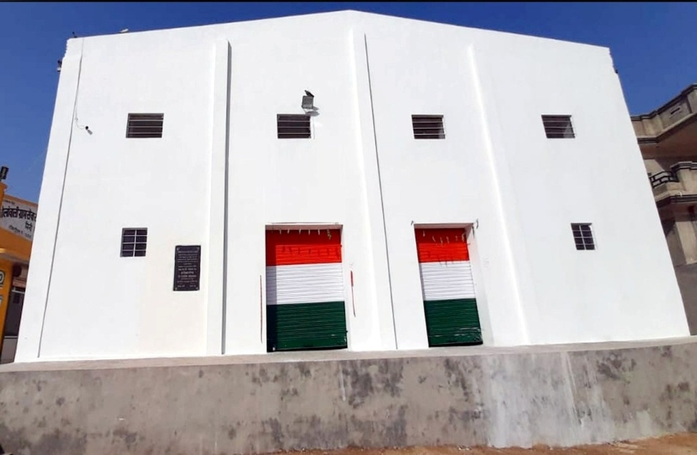
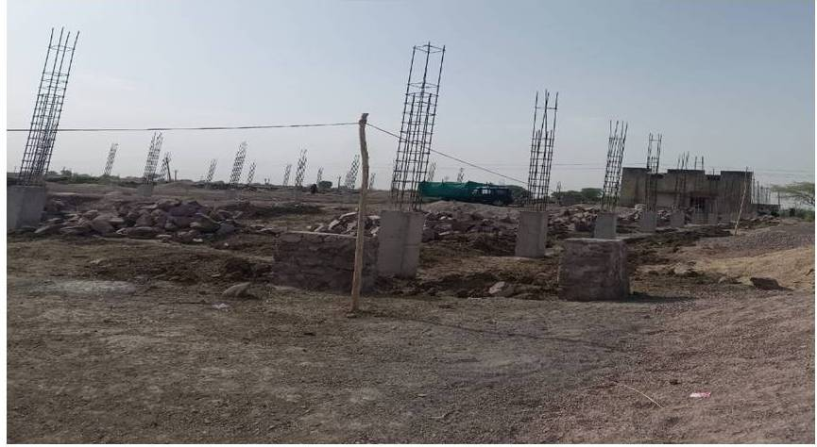
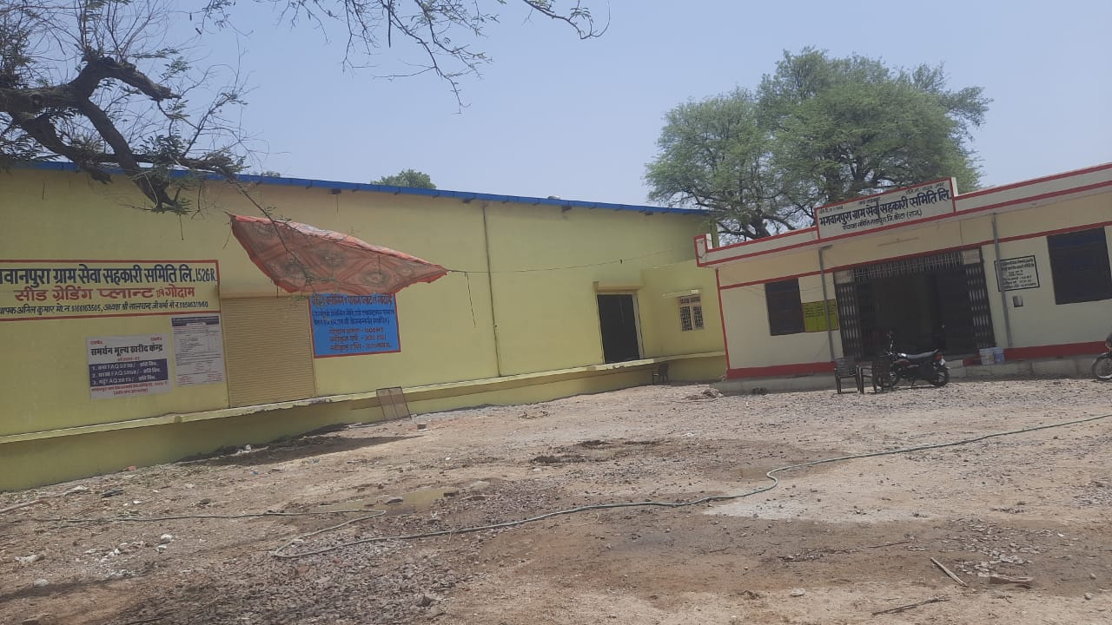
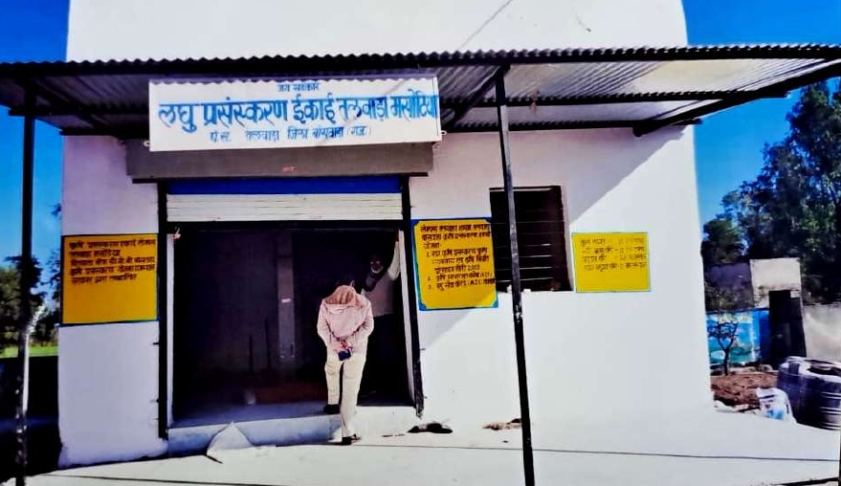
500 MT capacity warehouse Bolawali GSS, Distt. Hanumangarh
Under construction 5000 MT godown - Kotadi GSS, Distt. Kota
Cleaning-Grading-Sorting-Processing Unit - Bhagwanpura GSS, Kota
Cleaning-Grading-Sorting-Processing Unit - Talwada LAMPS, Distt. Banswara

Slide 11
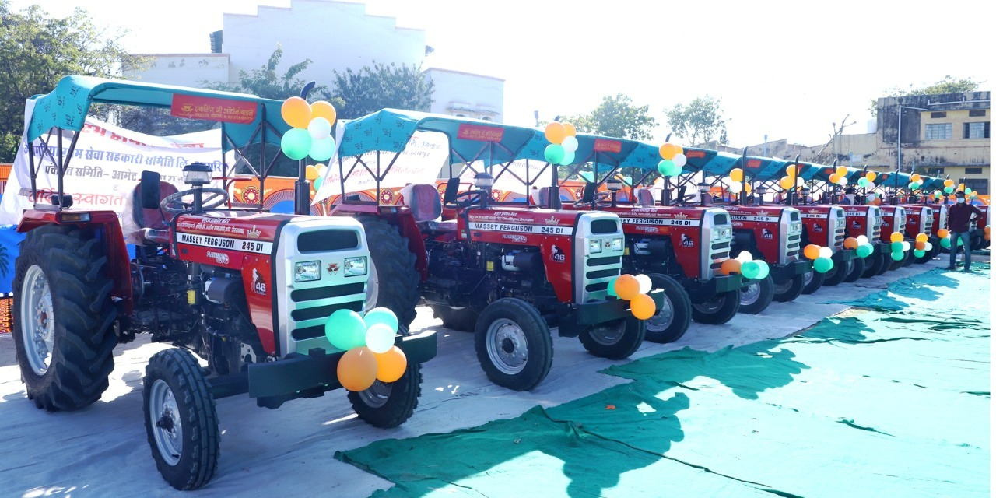
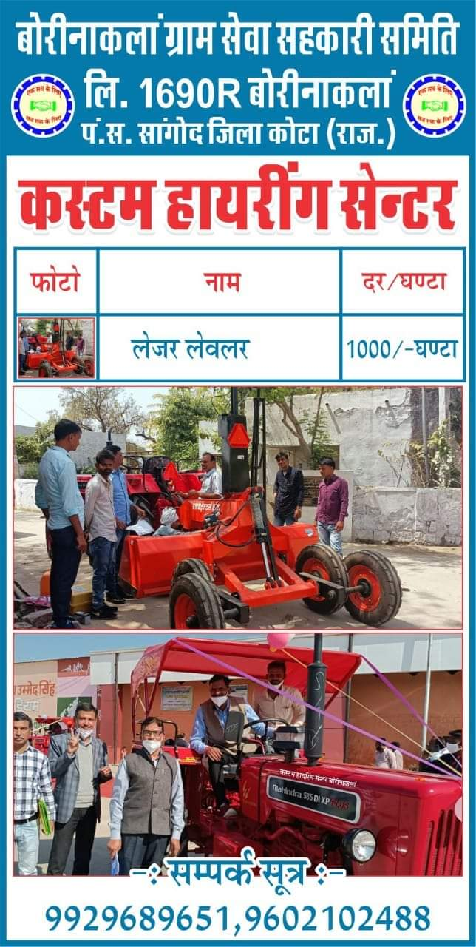
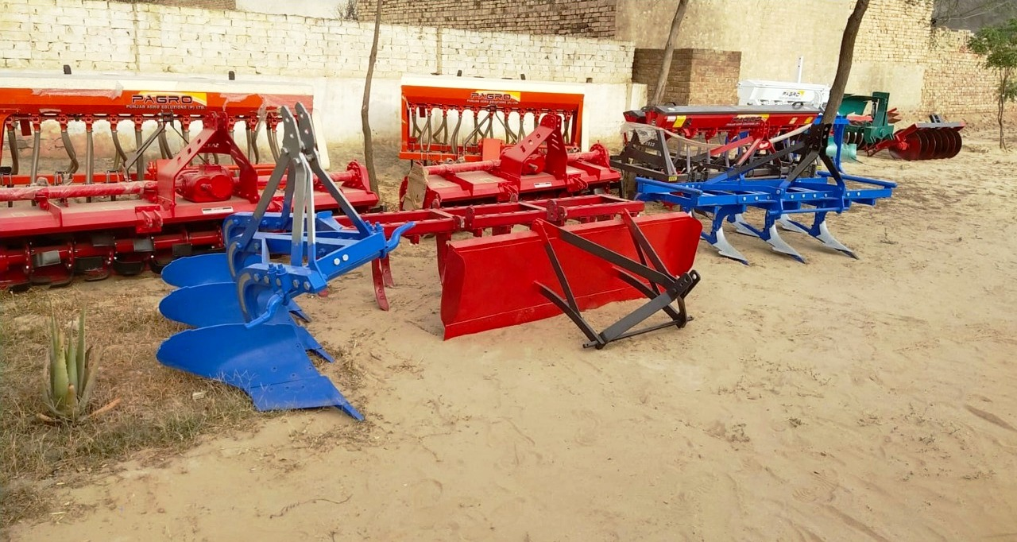
CHC - Aagariya GSS, Distt. Rajsamand
CHC - Goluwala Niwadan GSS, Distt. Hanumangarh

Slide 12
Credit Cooperative Societies
State Credit Cooperative Societies - 700
Multi-State Credit Cooperative Societies - 50
Effective implementation of the BUDS Act, 2019
Registration of complaints by Deputy Registrars in the Designated Courts
Online complaint registration
So far, 7059 complaints filed in DJ courts
BUDS Rules, 2022 notified
Vigilance Committee constituted in 2021 comprising of RCS and officers from Law and Police Department for effective implementation of MSCS Act, 2002

Slide 13
CONFED
34 Consumer Wholesale Bhandars, 120 Retail Outlets (Super Stores) and 469 Medical Outlets
Recently launched 14 organic products
Deepawali Fair and Spice Fair organized every year. Recently organized Spice Fair in May, 2022.
Provides medicines under RGHS through its 60 medical outlets in Jaipur and 469 medical outlets through District Wholesale Bhandars.
Institutional supply in government organizations/departments. Currently supplying supplementary nutrition to Aanganbadies in Rajasthan.

Slide 14
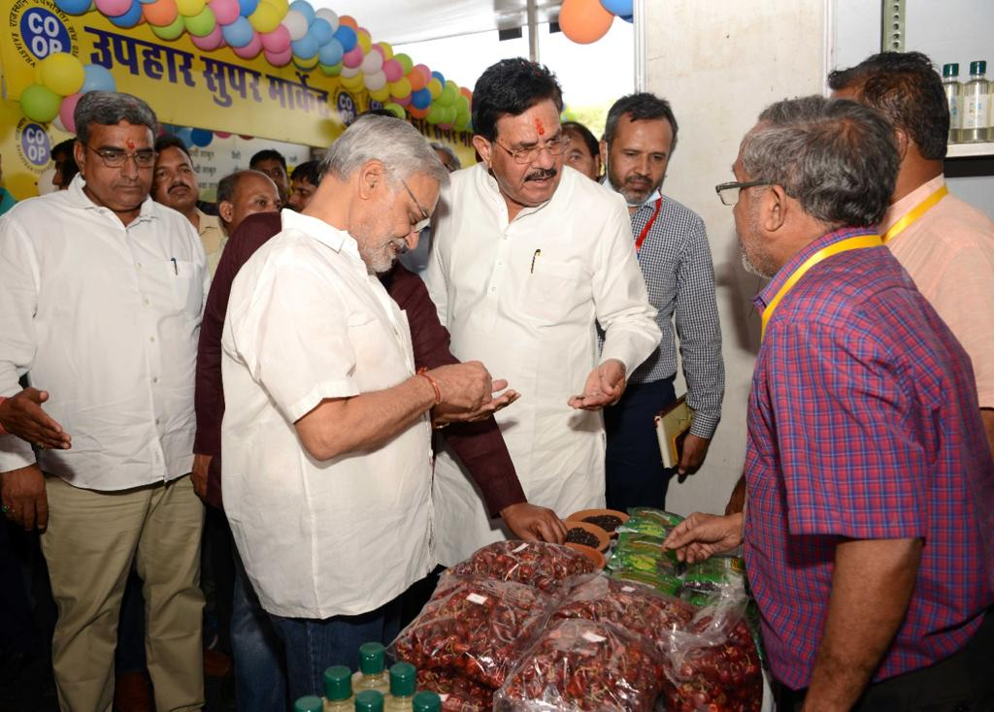
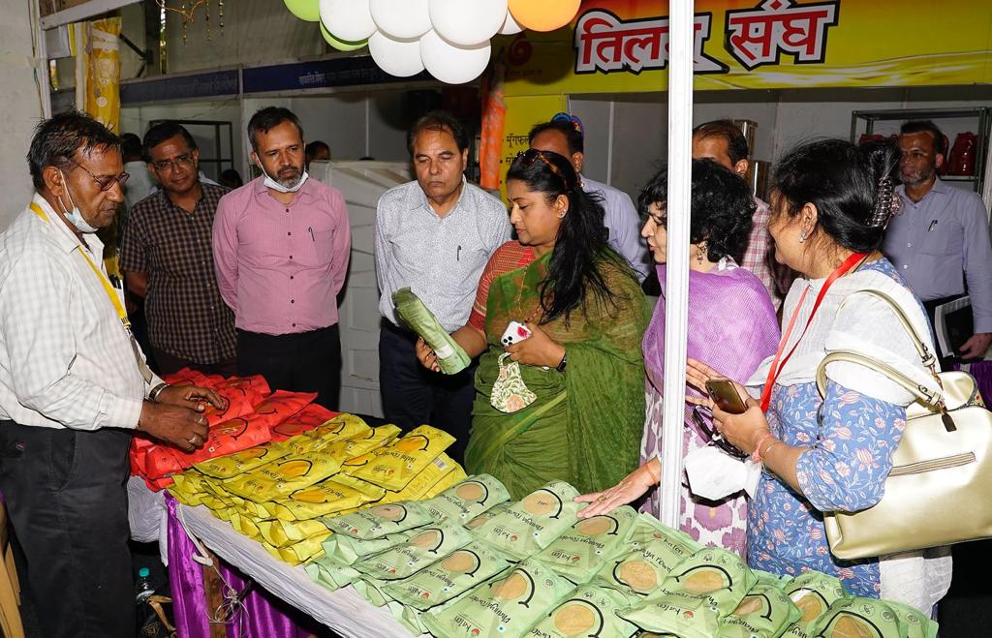
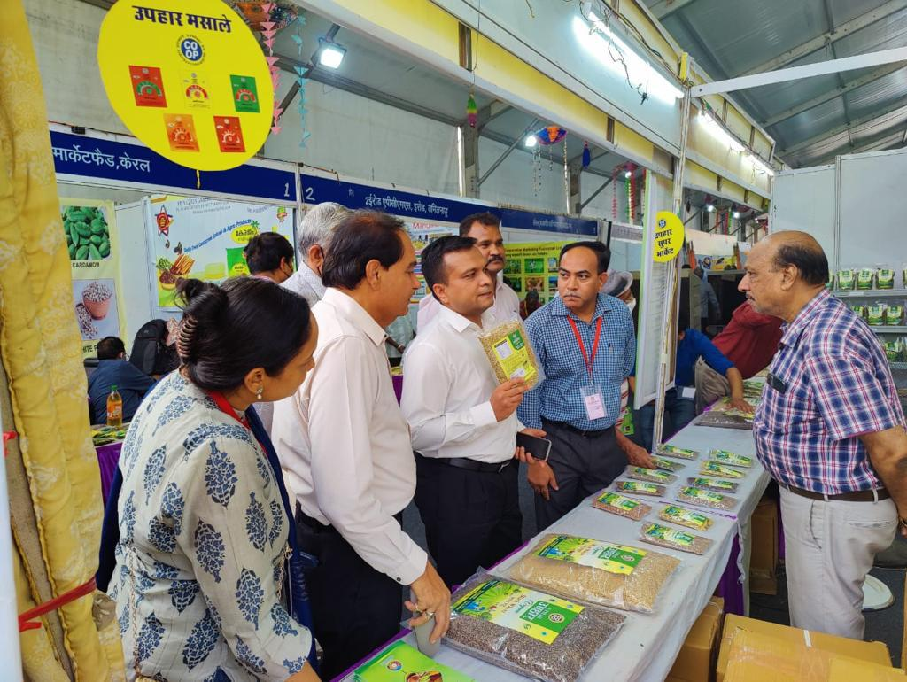
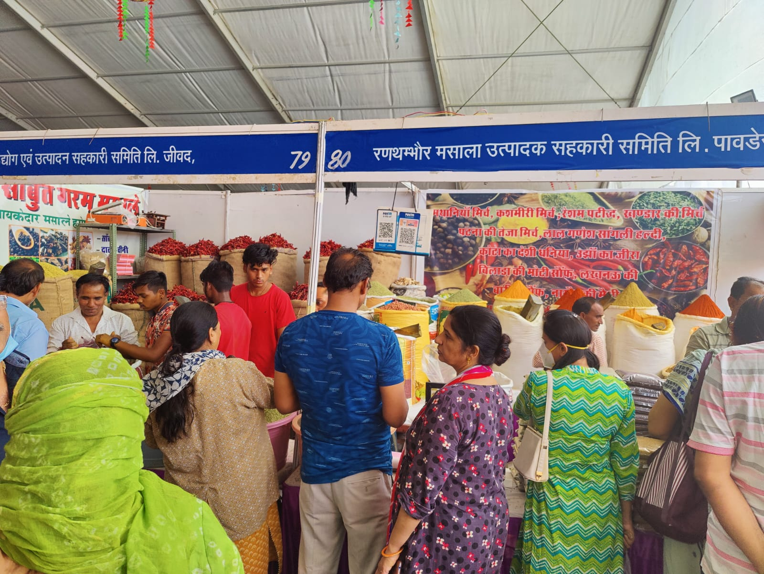
Spice Fair - May, 2022

Slide 15






Challenges
Making PACS self-sustainable
Diversifying the loan-portfolio of Cooperative Banks
Effective check and control on Credit Cooperative Societies; especially Multi state credit cooperative societies
Creating a robust legal framework for Cooperatives
Ensuring democratic participation in Cooperative societies
Capacity building of cooperators

Slide 16


