Slide 1


About the Cooperative Movement
DEPARTMENT OF COOPERATION - HIMACHAL PRADESH
1892 | First informal cooperative society at Panjawar in present Una District of H.P. was organized in India.
1904 | First Cooperative Societies Act enacted in India
1948 | 663 Cooperative Societies with membership of 18,375 in H.P.
1956 | First H.P. Cooperative Societies Act enacted in H.P.
1968 | H.P. Cooperative Societies Act, 1968 after re-organization of States
2020 | 97th Constitutional Amendment Act 2011 was adopted. HP Coop Societies (Amend) Act 2020 was passed.
2022 | 4881 functional societies with membership of 18.99 lakh

Slide 2
AUDIT
 | HP STATE COOPERATIVE SOCIETIES (AMENDMENT) ACT 2020
1 | To give more autonomy and self reliance to the Cooperatives inconsonance of the 97th Constitutional Amendment,2011. Present State Government has passed HP State Cooperative Societies (Amendment) Act 2020 and HP Cooperative Societies (Amendment) Rules 2021.
2 | All the Cooperative Societies/Institutions will now approve the statutory auditor in general house from the panel of auditors notified by the State Government.
3 | Now , no auditor shall be engaged to conduct the audit of a Cooperative Society/Institution for more than two consecutive years.
4. | Now , no auditor shall accept audit of more than 20 Cooperative Societies/Institutions for audit in a financial year.
5. | A Panel of Auditors comprising of Departmental Auditors, Retiree Auditors, Certified Cooperative Auditors and Chartered Accountants have been formed by the Department.

Slide 3
COOPERATIVE MANAGEMENT INFORMATION SYSTEM
Sr. No | Key Features
1 | Department has its own integrated website named https://coophp.nic.in/ It includes all the information such registration, audit reports, inspections, arbitration, liquidation etc.
2 | The site provides maximum information which the Public will like to know about the Department and the Cooperative Society. Public can access all the latest notifications, circulars, provisions of Act and Rules etc.
3 | Online Registration of Cooperative Societies and NGOs are done through this website. 100% Registration of Cooperative Societies under 1968 Act and NGOs under Societies Registration Act 2006. This has reduced the footfall in office and made system more transparent and speedy.
4. | To promote Ease of Doing Business, 46 e- Services are being provided through the website within a turn around time of 30 days.
5. | e-Certificates of the Registered Society can also be generated through this.

Slide 4
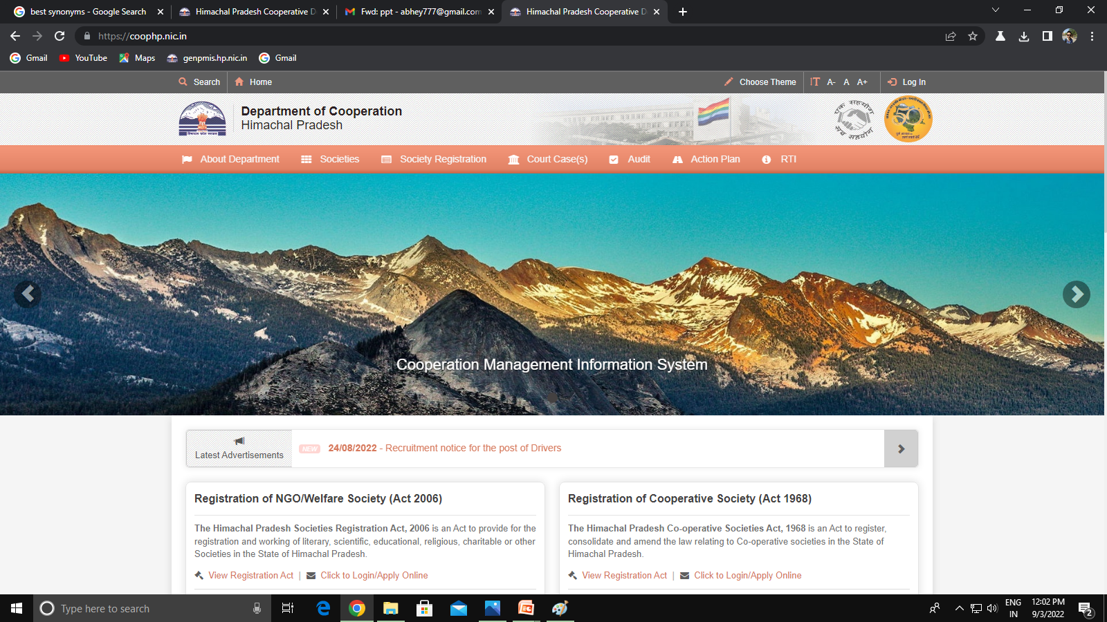
COOPERATIVE MANAGEMENT INFORMATION SYSTEM
Sr. No | Key Features
1 | Department has its own integrated website named www.hpcoop.nic.in It includes all the information such registration, audit reports, inspections, arbitration, liquidation etc.
2 | The site provides maximum information which the Public will like to know about the Department and the Cooperative Society. Public can access all the latest notifications, circulars, provisions of Act and Rules etc.
3 | Online Registration of Cooperative Societies and NGOs are done through this website. 100% Registration of Cooperative Societies under 1968 Act.
4. | To promote Ease of Doing Business, 46 e- Services are being provided through the website within a TAT of 30 days.
5. | e-Certificates of the Registered Society can also be generated through this

Slide 5
COOPERATIVE BANKING
Sr. No | Key Features
1 | Three major Cooperative Bank i.e. HP State Cooperative Bank Ltd Shimla, The KCCB Ltd Dharamshala and Jogindra Central Coop Bank Ltd Solan are functioning in the state.
2 | Total network of 548 branches and more than 2144 PACS are extending agriculture credit facilities to farmers.
3 | Cooperative Banks as on 31st March,2021 has market share of 20% in HP Banking Industry.
4 | Cooperative Banks have an ATM Network of 217 in the state. And 2 Mobile Vans are also operational for Awareness Campaigns.
5 | These banks are also instrumental in implementing the Central and State Govt sponsored scheme.
6 | The agriculture credit to the farmer as per the mandate of Government of India is being provided at the rate of 7% per annum with 3% interest subvention on timely repayment.

Slide 6
COOPERATIVE BANKING IN HIMACHAL PRADESH
Jogindra Central Cooperative bank operating in 1 District
Agriculture Cooperative Training Institute ACSTI, catering to training needs of banking sector & Cooperative sector has been awarded 1st by NAFSCOB
Jogindra Central Cooperative bank operating in 1 District
Kangra Central Cooperative Bank operating in 5 District
16.53%
Kisan Credit Card (KCC)
State Business = 8013331.47
HPSCB Business = 132436.11
25.68%
NRLM
State Business = 11980.02
HPSCB Business = 3077.00
Share of HPSCB in the total business of the State
10.53%
PMEGP
State Business = 22439.48
HPSCB Business = 2362.27
23.42%
PMSBY
JEEVAN HAI ANMOL
101798.00 - State Business –131708.00
23838.00- HPSCB Business – 30447.00
23.12%
PMJJBY
5 Urban Cooperative Banks catering to Banking needs in Urban areas Mandi, Chamba, Parwanoo, Baghat & Shimla.
15.51%
MMSY
MMSY
State Business = 33866.30
HPSCB Business = 1868.01

Slide 7
TRAINING MODULE
Sr. No | Key Features
1 | Himachal Pradesh State Development Federation Limited (HIMCOFED) is the state nodal agency for conducting training programs to all the stakeholders of the Cooperatives in the state i.e. Departmental Auditors, Managing Committee Members, Certified Auditors, Board Members etc.
2 | Training is being provided by the institute at all 3 levels i.e. the State Level, District Level and Block Level.
3 | Training Module has been formulated by the Department with collaboration of HIMCOFED. It includes all types of Societies and specific need based training for Secretaries and Managing Committee Members.
4. | Training Module includes Guests Lectures from the Cooperative Sector Experts including Departmental Officers, NABARD Officers, Experienced Officers from big Cooperatives like IFFCO, HP State Coop Bank Ltd etc.

Slide 8
COMPUTERIZATION OF PACS
Scheme of GOI with a funding ratio of 90:10(Central/State). Being implemented by Joint Registrar (Credit) as State Nodal Officer.
State Level Monitoring Committee and District Level Monitoring Committees notifications have already been done.
Specific budget provisioning has also been done in HP State Budget.
4. GOI funding will be released into the State Nodal Account (SNA). State Bank of India (SBI) has been requested to open State Nodal Account of Himachal Pradesh.

Slide 9
CONVERSION OF PACS INTO MSCs
1 The Govt. of India has started an ambitious scheme for the modernization of PACS through NABARD by converting them into Multi Service Centres.
2. Under this scheme PACS would be provided financial assistance for infrastructural development i.e. installation of Agri & Cold storage, Agriculture services & processing, Agriculture produce marketing and transportation centres, consumer stores etc @ 4% rate of interest.
3. Against the target of 50 PACS , 46 PACS have so far been identified by the department while 9 others are under the process with NABARD for conversion into MSCs. Under this scheme, an amount of Rs. 11.19 crore has already been sanctioned by NABARD.

Slide 10
CENTRAL SPONSORED SCHEMES
1. NCDC & NABARD are implementing Center Sector Scheme for the formation and promotion of Farmer Producer Organization (FPO). NCDC has founded 20 FPOs under HP Cooperative Societies Act, 1968 and NABARD has registered 16 FPOs under company’s Act under the scheme.
Financial Assistance under the scheme
Formation & Incubation Cost: 25 Lakhs for 5 years
Management Cost: 18 Lakhs for 3 years
Matching equity ceiling: 15 Lakhs
Collateral free loan: upto 2 Crore

Slide 11
CENTRAL SPONSORED SCHEMES
2. Government e Marketplace (GeM) Portal
Onboard Cooperative Societies as buyers on GeM Portal. Societies with minimum turnover of Rs 100 Crores are eligible for this.
5 Cooperatives are already onboard on GeM Portal up till now i.e. HP State Coop Bank, Kangra Central Coop Bank, Jogindra Central Bank, Agriculture Rural Development Bank & MILKFED.
District Cooperative Officers will be the field functionaries for this portal. DCOs training have already been completed.
For smooth functioning , Joint Registrar (Marketing) has been designated as the Nodal Officer in the state.

Slide 12
STATE SPONSORED SCHEMES
Yuva Sehkar Kosh Scheme, 2022
Department of Cooperation H.P. “Yuva Sehkar Kosh Scheme” will benefit those left out small and marginal farmers who are cultivating crops other than the crops selected for the particular block under different central sector schemes. Under this scheme all the FPOs shall be registered as cooperative societies thereby give more momentum to the cooperative movement of the State. This is sought to be done by facilitation of convergence in existing schemes of State and Central Govt. agencies.
Sailent features of the scheme
Financial Assistance under the scheme:-
  Training and Community mobilisation support:- Rs. 25,000/-
  FPO management cost:- Rs. 2 Lakhs
  Seed money equal to double of the Equity Grant:- Maximum 15 Lakh
The Inspector Cooperative from the concerned area will act as mentor of the FPO.
Involvement of educated local youth.
Exemption of Audit fee.

Slide 13
ACHIEVEMENTS
In Himachal Pradesh 100% villages covered under the hold of Cooperatives.
2. 18.99 Lakh people of Himachal Pradesh are directly connected with Cooperative Sector.
Restrictions imposed on accepting deposits from Non-members in compliance to the provisions of Banking Regulation Act, 1949 and recent The Banning of Unregulated Deposit Scheme Act, 2019. In addition to this State |Govt. has constituted the court of District and Session Judge Shimla as designated Court for trial of offences in the State of H.P. and Secretary (Finance) to the Govt. of H.P. as competent authority for the purpose of this ordinance.
4. FPO Success Story :- The Prayas Farmer Producer Cooperative Society Ltd in Gohar Block (Mandi) has demostrated impact of collectivization of small and marginal farmers. It has done a business of Rs 6,58,742 within the year of establishment benefitting 175 members and increased the income of the farmers by 10-15%.

Slide 14

THANKS

