Slide 1

Presentation
on
The Achievements in Co-operative Sector and Initiative taken to attain the goals of “ Sahkar- Se- Samriddhi”
Government of Tripura
Department of Co-operation

Slide 2
Brief History
Tripura is a small hilly state in the North East Region of India and surrounded by Bangladesh on the three sides. The state of Tripura is connected with the rest of the country through a National Highway and railways.
Co-operative movement in the state has been playing a vital role for the socio-economic development and cultural advancement of the people .
The Co-operative movement in Tripura started in the year 1949, with the registration of “Swasti Samabaya Samity Ltd”, Kanchanpur, North Tripura District for re-settlement of the refugees came in Tripura from East Pakistan due to civil unrest.
The Co-operative movement acquired a comprehensive character with the enactment of Tripura Co-operative Societies Act 1974 and Tripura Co-operative Societies Rules, 1976.

Slide 3
Profile
There are 8 (eight) District Level offices headed by DRCS & 17 (seventeen) Sub-Division level Offices headed by ARCS functioning and at the bottom Level, 56 Circle Offices are there under different Blocks.
The Co-operative moment of Tripura enjoys two tiers systems – Apex Co-operatives at the State Level and Primary Co-operatives at the grass root Level.
There are 3761 Co-operative Societies functioning. Of which, there are 11 nos. of Apex Co-operatives, 14 nos. Marketing Co-operatives, 56 nos. of LAMPS, 212 nos. of PACS, 330 nos. of Fishery Co-operatives, 411 nos. of Diary Co-operatives, 297 nos. of ARD Linked Co-operatives, 285 nos. of Consumer Co-operatives and 2145 nos. of Other types Co-operatives.

Slide 4
Key Activities of the Co-operation Department
Registration of Co-operative societies under TCS Act ,1974.
Registration of NGOs /Societies under Societies Registration Act, 1860.
Audit of Accounts of Co-operatives Societies.
Inspection and enquiry into the affairs of Co-operative societies
Election of the management committees of Co-operative Societies.
Winding up of defunct / non- functional Co-operative Societies.
Settlement of Disputes of Co-operative Societies.
Extending financial assistance to the Co-operative Societies for their all round development and growth.
Coordination between the Co-operative Societies and NABARD, NCDC, GOI for the greater interest of the Co-operative fraternities.

Slide 5
Major Achievements
01) Online Registration of Co-operatives and members enrollment:-
The Department has achieved the set target for establishment of at least 1(one) Co-operative Society in each & every Gram Panchayat /ADC Village. As on date, 3761 nos. of Co-operatives in different areas with a total membership of 8.60 lakh have been formed.
As a part of “Ease of Doing Business” initiative, the department has already launched online Registration of Co-operative Societies through single window “Swaagat” Portal.
Last 5(five) years performance is as under :-
Sl. No | Particulars | 2017-18 | 2018-19 | 2019-20 | 2020-21 | 2021-22
1 | No. of Co-operatives registered | 08 | 255 | 782 | 319 | 102
2 | No of members enrolled | 112 | 3570 | 10948 | 4466 | 1428
3 | No. of NGOs Registered | 782 | 319 | 243 | 193 | 264

Slide 6
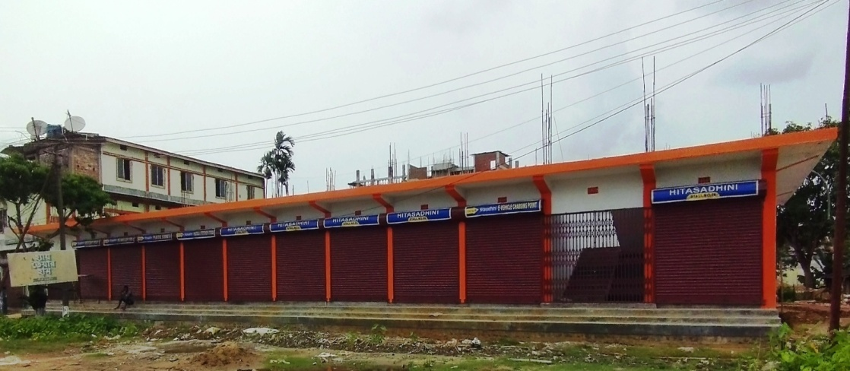
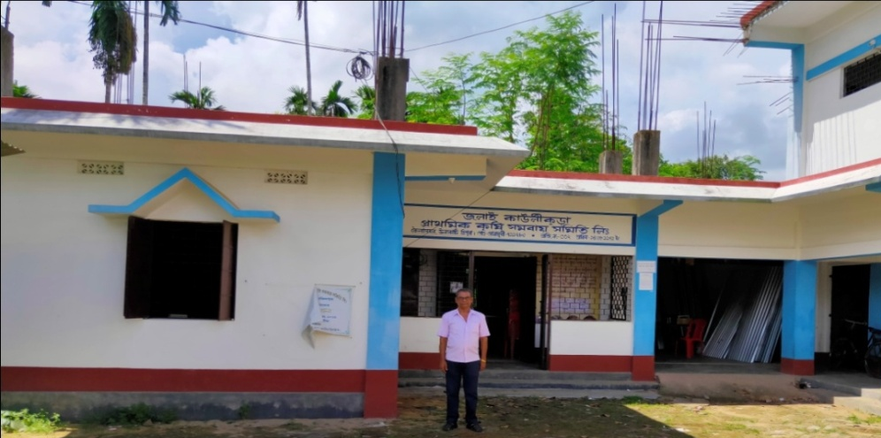
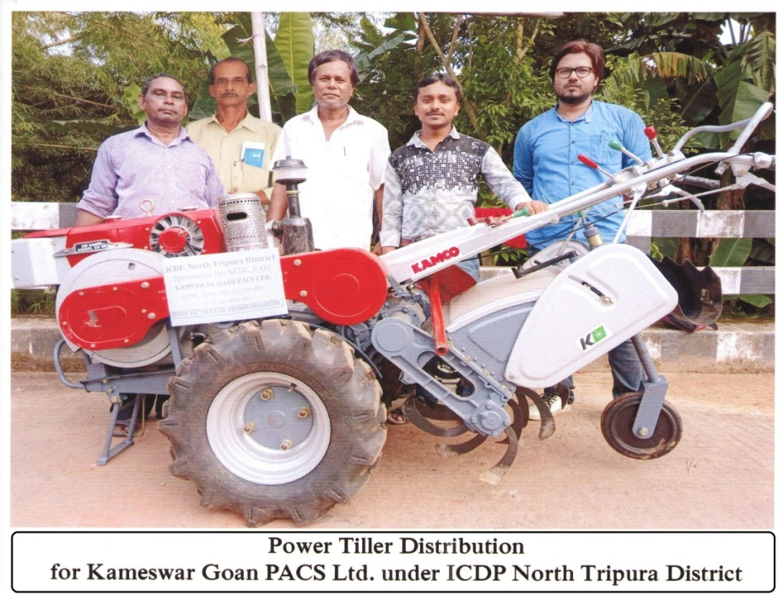
02) Implementation of Integrated Cooperative Development Project(ICDP)
3 (three) ICDPs under the aegis of NCDC, with a total project outlay of Rs. 26.61 crore are in operation in Dhalai, North & Unakoti Districts of Tripura.
The project implementation would be completed in March, 2023.
As output of the project implementation, a good numbers of critical infrastructures like go-down cum offices, shopping complexes, transport vehicles, water projects, furniture and fixtures, deposit counters etc have been created in 111 nos of beneficiary societies. Besides, creation of infrastructure in respect of more 58 societies are in progress.
Market Complex of Hitasadhini PMCS, North Tripura District
100 MT Go-down cum Office with Shop
POWER TILLER DISTRIBUTED TO KAMESHWAR PACS

Slide 7
03) Implementation of ‘PACS Computerization Scheme’ of the Government of India
The State Government has already given consent for implementation of ‘PACS Computerization Scheme’ in Tripura for transformation of all 268 PACS into multi-service centers and their required technology up-gradation.
The proportionate 10% share of the state Government has already been provided in the budget for 2022-23.
The State & District level Monitoring Committees have already been constituted by the State Government.
The SNA Account to enable PFMS transaction under the project has been opened by the state Government.
Audit of Co-operative Societies has been completed upto the period of March, 2022.

Slide 8
04) Tripura State Co-operative Bank(TSCB)
Tripura State Co-operative Bank has been functioning as an Apex Co-operative Bank in the state. The short term loan through DBT is provided directly to the farmer-members as sponsored by the LAMPS & PACS.
At present, the Bank has 66 branches spread over the state covering both rural & urban areas. Apart from extending institutional credit support, the bank has been implementing various Government sponsored scheme successfully.
The bank has been mobilizing its effort for formation of JLG as well as SHG for providing credit support.
The TSCB has been declared as SCHEDULED BANK by the RBI. The Bank is already put on CBS platform and the services like ATM, Mobile Banking, BBPS, PFMS, AePS, Digital Dashboard with internet banking (view only) have been introduced. TSCB is recognized by the NABARD as the best SCB in the North East region during the year 2020-21 . Key indicators of TSCB are as under:-
(Rs in crores)
Sl.No | Particulars | 2017-18 | 2018-19 | 2019-20 | 2020-21 | 2021-22
1 | Total Deposit | 2622.10 | 2862.94 | 2862.50 | 3103.70 | 3060.01
2 | Total Loan/Adv | 1440.82 | 1681.14 | 2176.31 | 2231.73 | 2456.43
3 | C.D Ratio | 54.95% | 58.72% | 76.03% | 71.90% | 80.28 %
4 | JLG Funding | 12.15 | 13.12 | 8.55 | 5.76 | 7.12
5 | KCC Funding | 38.02 | 6.70 | 43.20 | 48.43 | 59.11
6 | Net Profit | 13.85 | 15.59 | 17.75 | 19.67 | 20.73

Slide 9
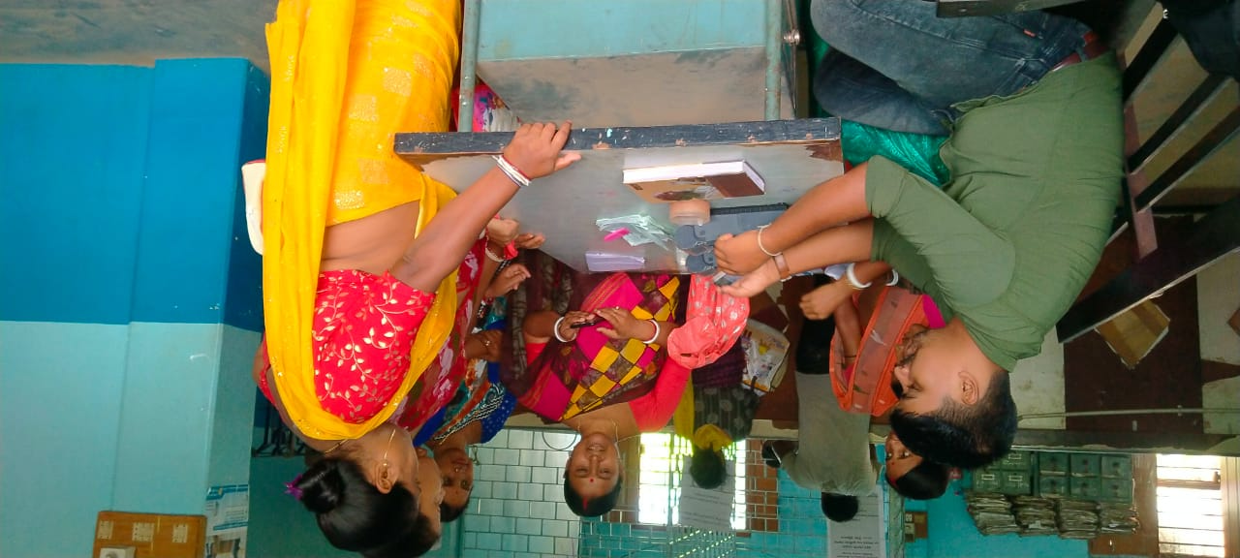
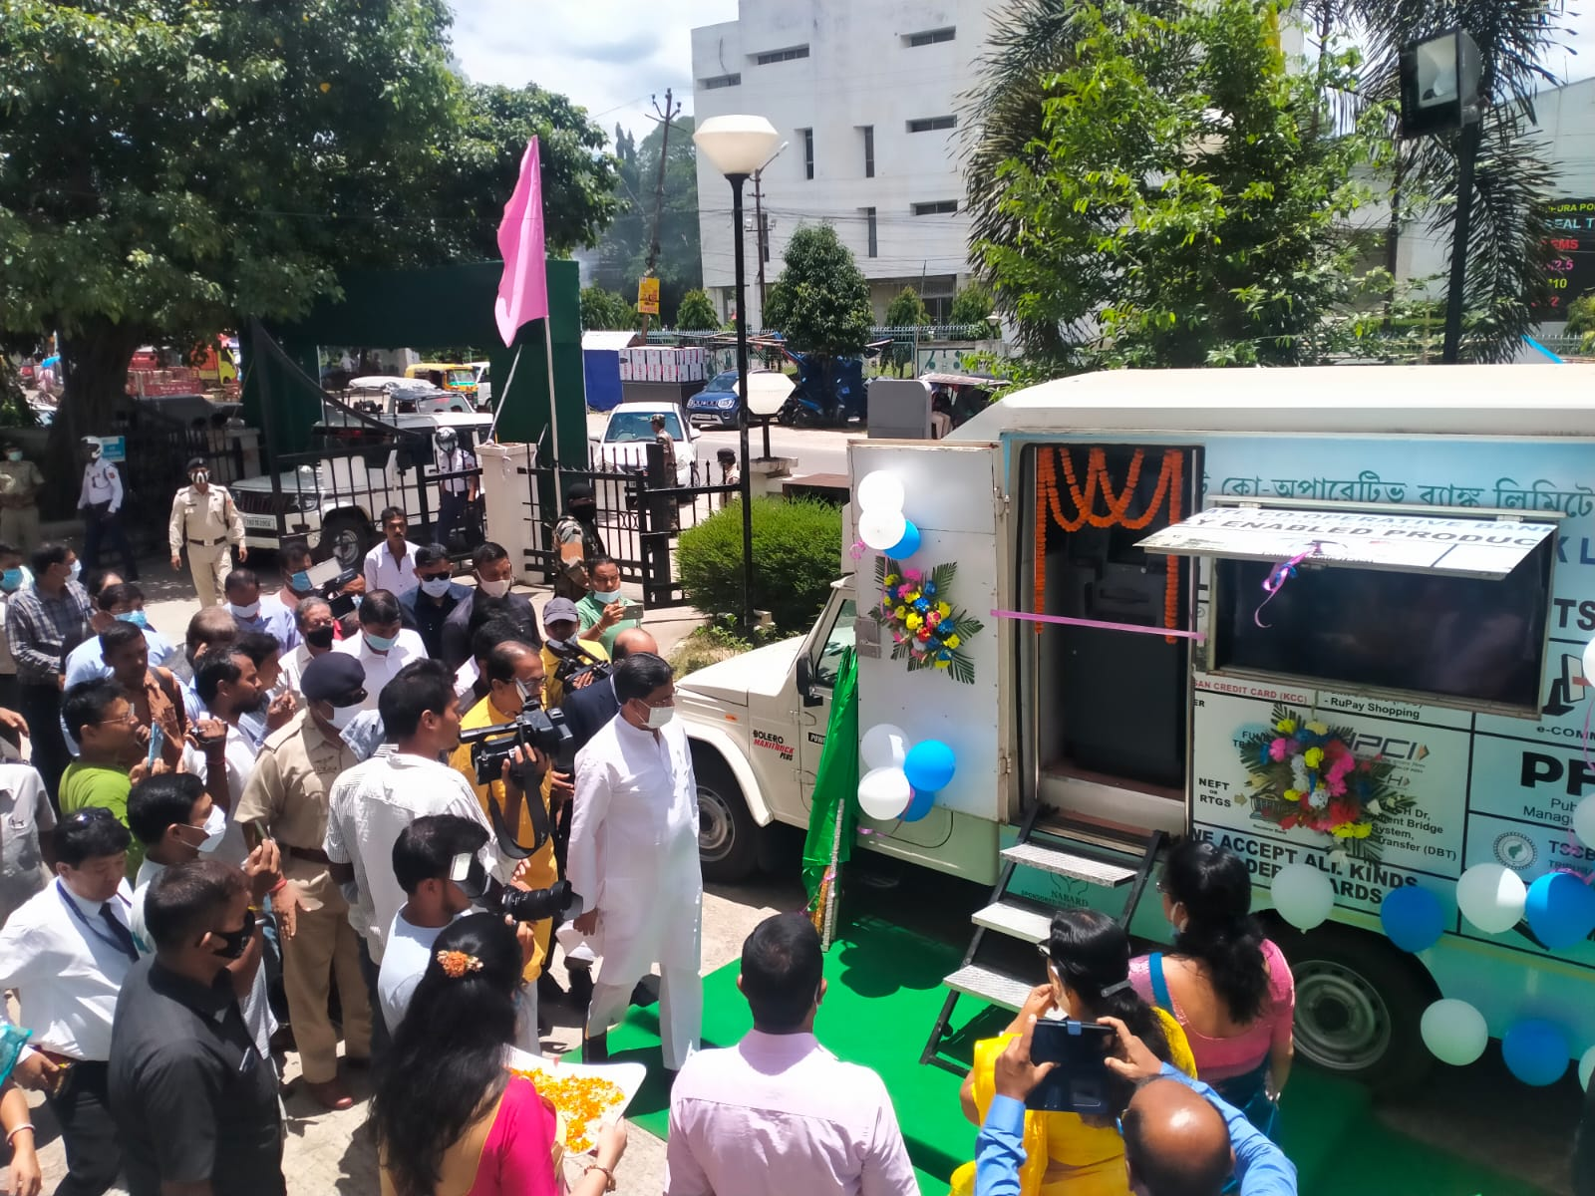
TRIPURA STATE CO-OPERATIVE BANK LTD.
Inauguration of Mobile ATM Van
Payment of wages through Micro ATM

Slide 10
05) Gomati Co-operative Milk Producers Union
The Gomati Coop. Milk Producers Union under the brand name “Gomati” is the only Apex level Dairy Co-operative Society in the State procuring raw milk from 5936 milch farmers families through its 141 Primary Milk Producers Co-op. Societies.
The Milk Union has also set-up one more “Milk Chilling Plant” having 5000 liter capacity in Sepahijala District.
Per day 7500 liters of raw milk are being collected and the procurement trend is increasing day by day.
Apart from processing, the Milk Union has started preparing and marketing of sweet items, paneer, Ice-creams and curds etc.
Gomati Milk union has opened 5(five) Milk parlors in different strategic locations of Agartala City. The performance matrix of Gomati Milk Union for last 5(five) years is as under :-
Sl. No | Particulars | 2017-18 | 2018-19 | 2019-20 | 2020-21 | 2021-22
1 | Milk Collection (in Kg) | 21,45,122 | 20,52,818 | 28,28,866 | 25,57,099 | 17,27,206
2 | Milk producing farmers (in no.) | 5,700 | 7,020 | 7,740 | 8,240 | 5,965
3 | Milk Producers co-operative (in no.) | 95 | 105 | 117 | 121 | 133
4 | Marketing of Liquid Milk (in liter) | 45,13,438 | 48,30,094 | 43,99498 | 31,44,322 | 26,21,951

Slide 11
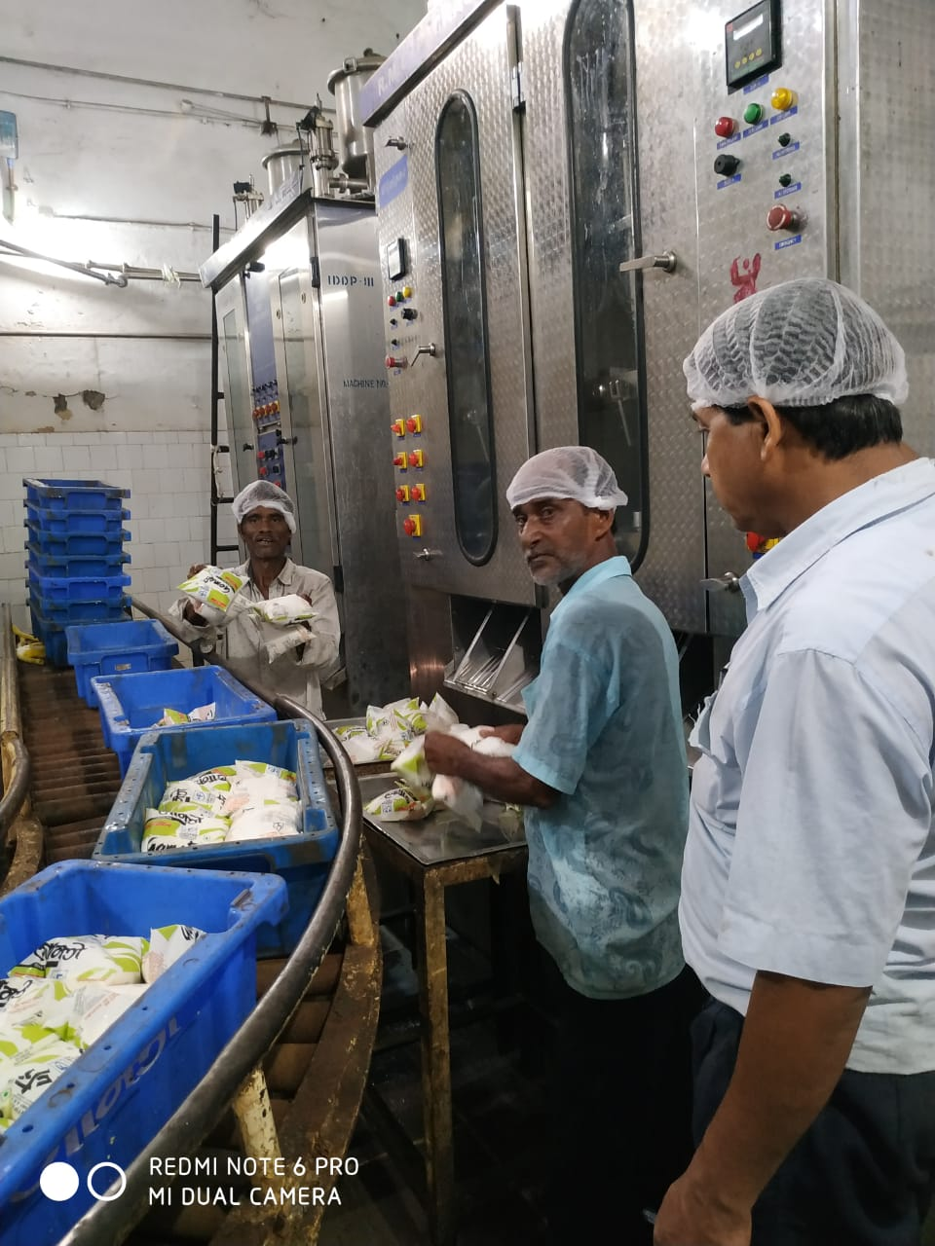
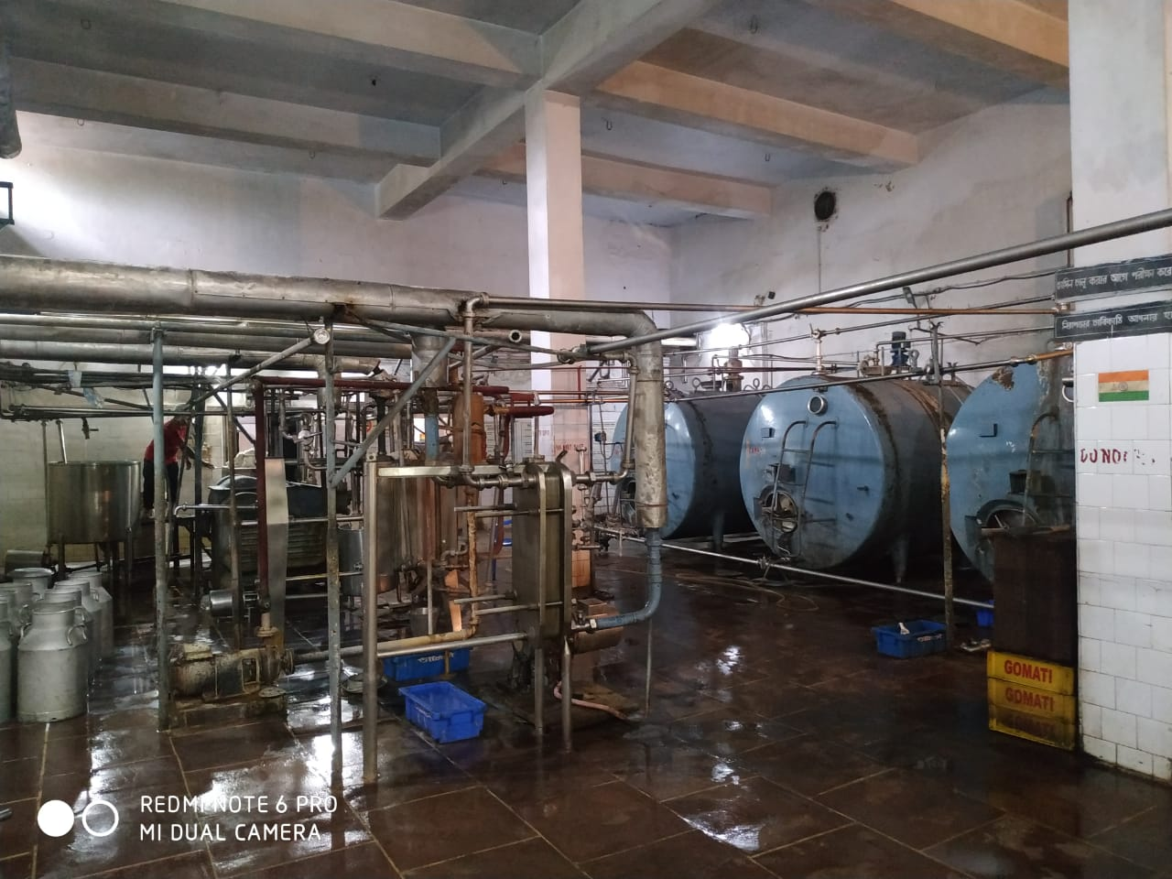
GOMATI CO OPERATIVE MILK PRODUCERS UNION
Packaging of GOMATI Milk Products
Milk Chilling Plant of GOMATI

Slide 12
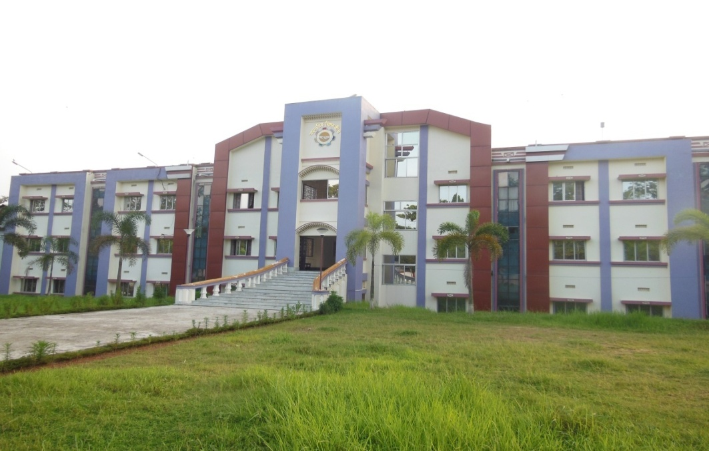
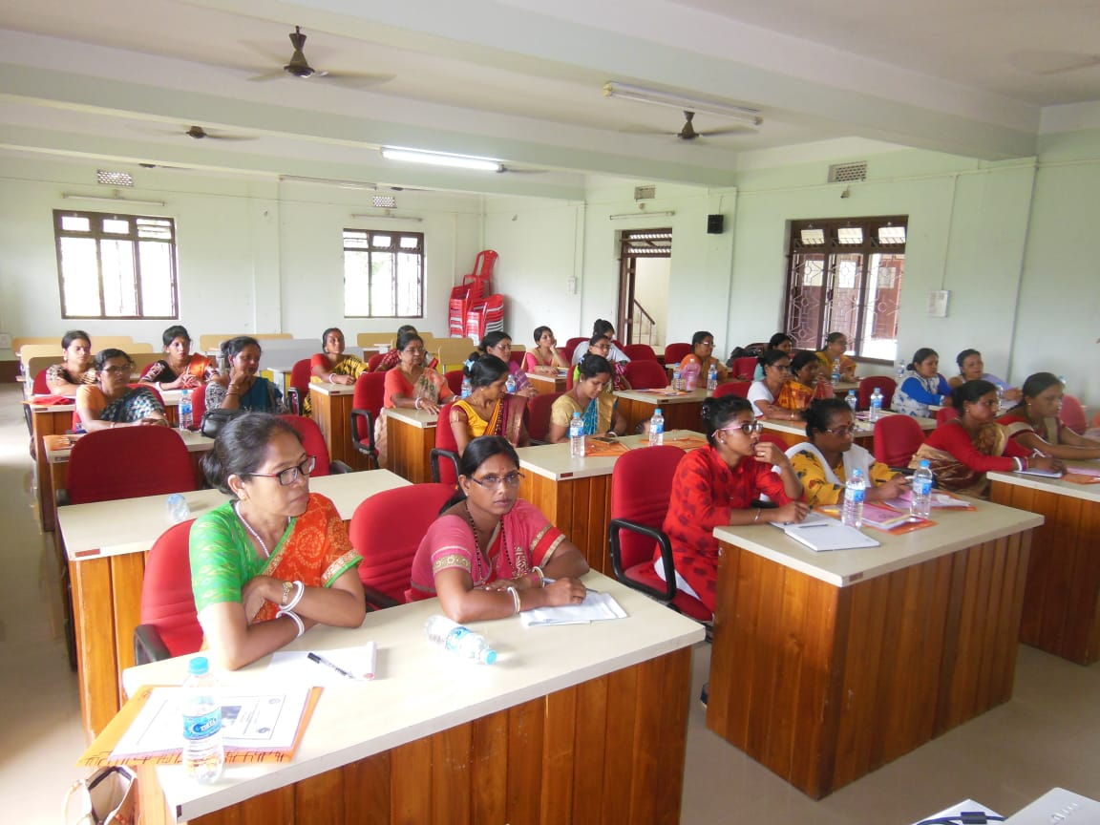
06) Tripura State Co-operative Union
Tripura State Co-operative Union(TSCU) is the sole Apex level Co-operative organization has been functioning in the area of education and training since the year 1954.
The TSCU has got his own (land & building) infrastructure support which includes 100 bedded hostel facilities , computer Labs, Library, Conference hall, Class rooms with modern amenities.
It has been mandated to conduct training and education classes, seminars , workshops, publications & printing etc.
The state Government has been providing financial assistance to implement the training & education pogramme.

Slide 13
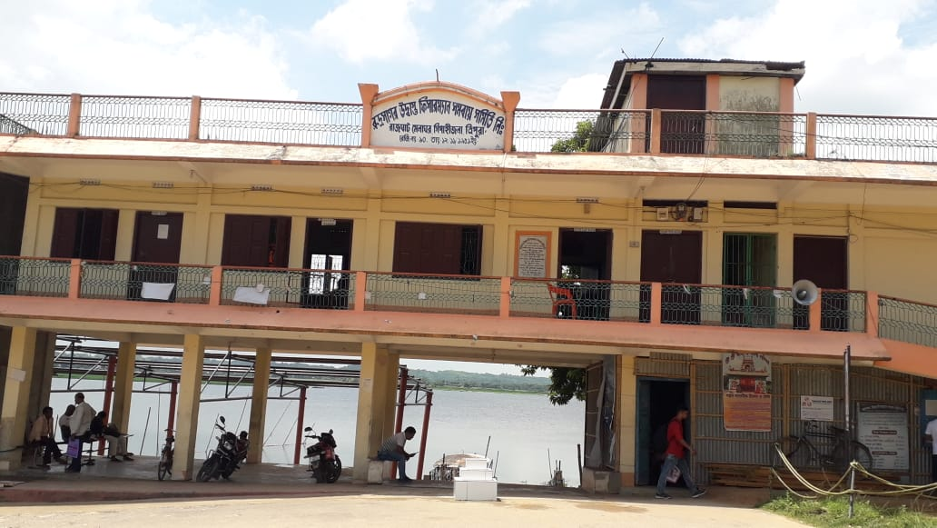
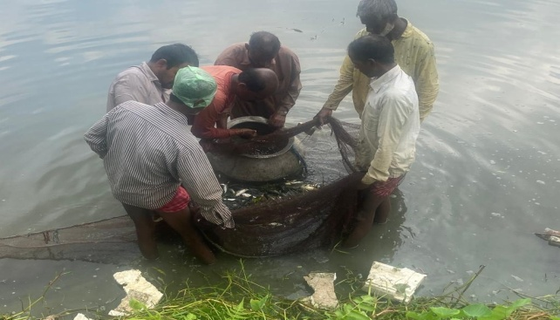
07) RUDRASAGAR UDBASTU FISHERMAN CO-OPERATIVE SOCIETY
Rudrasagar Udbastu Fisherman Co-operative Society with a membership of 2000 fishermen is involved in pisciculture activities in its own water body measuring 14430.47 acres.
Apart from fishing, the society has been earning revenue income from boating and angling through ticketing system.
During the year 2021-22, the society earned a net profit of Rs. 35.98 lakh after meeting all administrative expenses.
The society is empowering its fishermen members through various development programs in a sustained manner

Slide 14
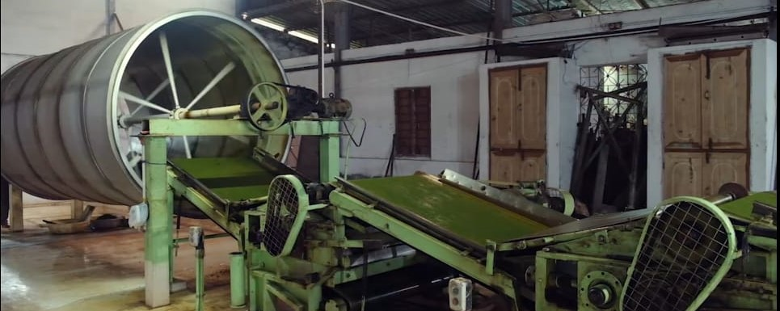
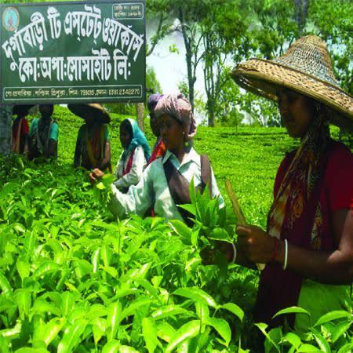
08)Durgabari Tea Estate Workers Cooperative Society
Out of 34 nos of Tea Garden Cooperative Societies in Tripura, Durgabari Tea Estate Workers Cooperative Society is the best performing Tea Cooperative Society. This Society is collecting approx 9 lakh kg Green leaves every year.
The total area under tea plantation is 183 Ha. and it has its own processing plant with capacity of 12,000 kgs. per day. Recently the plant has been converted to CNG based from coal based chamber.
The society has been selling 4.5 lakh kg of made tea per year with a turnover of Rs. 9.00 Crore.
The Society has guaranteed the employment generation of 300 dependant families.

Slide 15
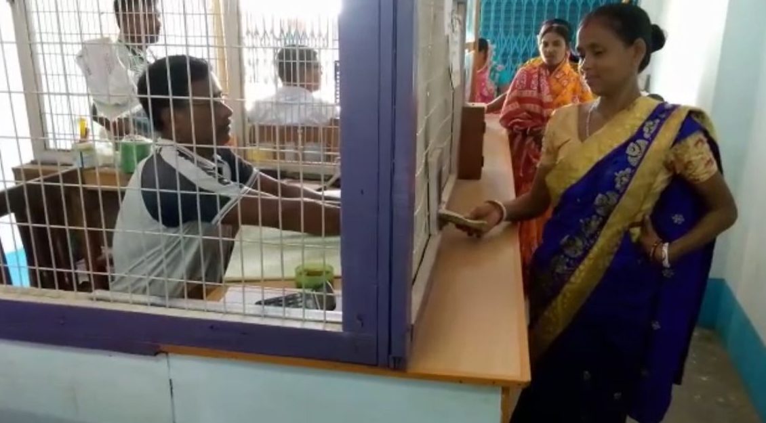
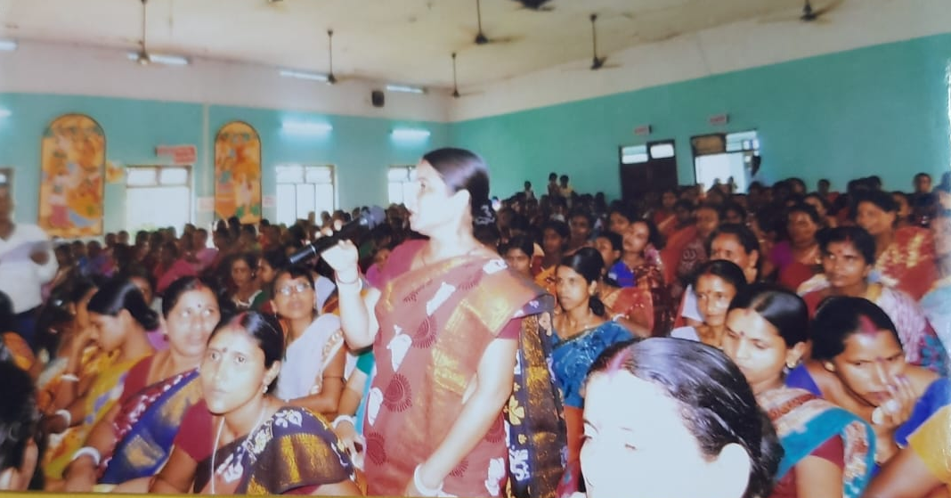
09) Popular Women Cooperative Credit And Thrift Society
Popular Women Cooperative Credit and Thrift Society, Udaipur is the only women driven Cooperative Society in the State which had been awarded ‘Best Performing Women Cooperative Society’ in the North East region by the NCDC.
This society is engaged in deposit mobilization activity exclusively with the women members through its ‘Deposit Mobilization Center’ and it has the track record of sustaining profit every year. The society is also involved in activities related in Mushroom production, clay toys & embroidery etc.
Also the management is conducting training for women entrepreneurs on skill development & various kinds community based production training/ hand holding.
Besides, the society has been campaigning against social evils like drug addiction, dowry system , domestic violence and other social activities.

Slide 16
New Initiatives of the Department
Sl No | Initiatives
01 | Department has already undertaken Modernization of Co-operative Training Institute under Special Assistance Scheme with a project outlay of Rs. 6.23 Crore
02 | Construction work of one Co-operative Complex in Teliamura, Khowai District with a project cost of Rs. 2.32 Crore under Special Assistance Scheme has already been taken up.
03 | Construction of office building of District level Co-operative office (DRCS) at Sepahijala District with a cost of Rs. 2.00 Crore under Special Assistance Scheme has been under taken.
04 | Inauguration of the Petrol Pump cum CNG Station at Udaipur is planned by the Tripura State Co-operative Consumer Federation Ltd. (TSCCF) in the month of September, 2022
05 | The TSCB has planned to open 14 new Bank Branches in different potential areas in phases by the end of March,2023.
06 | Department has planned to open the 5(five) new Sub-Divisional (ARCS) Offices in this financial year.

Slide 17
THANK YOU

