Slide 1

GOVT. OF HARYANA COOPERATION DEPARTMENT

Slide 2
MAIN ACHIEVEMENTS
Haryana has been paying the highest ever Sugarcane Price of Rs.362/- per quintal in the Country.
Export order of 20,000 MT Basmati Rice valuing 21.85 Million USD received from Saudi Arabia - 1st of its kind initiative.
Procured 7.8 Lakh MT Bajra and 7.5 Lakh MT Mustard Seed at MSP during 2020-21 – highest procurement of Bajra and Mustard Seed by any State.
Interest free crop loan to prompt payee member of PACS.
Banking Operation in 307 PACS integrated online with DCCB’s , 100% to be completed by November 2022.

Slide 3

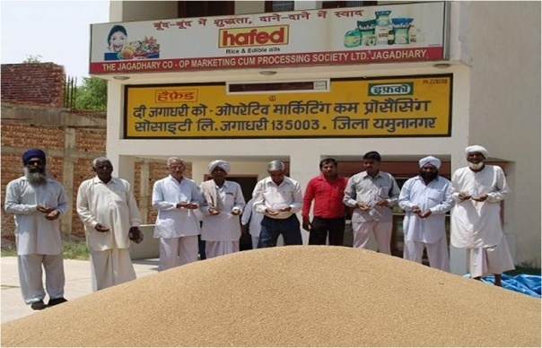
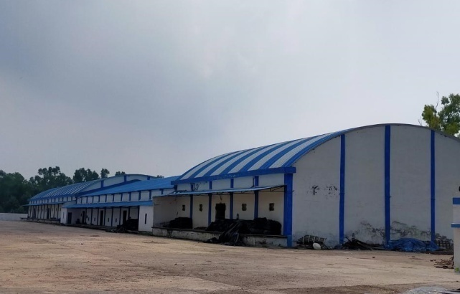
FOODGRAINS PROCUREMENT & WAREHOUSING
Minimum Support Price (MSP) : 9 commodities i.e. Wheat, Paddy, Bajra, Maize, Mustard Seed, Sunflower Seed, Groundnut, Black Gram, Moong are procured at MSP.
More than 40% of wheat and 30% of Paddy of the total Wheat & Paddy procured by the state is procured by HAFED at MSP every year.
Procured 5.06 Lakh MT Bajra at MSP during 2020-21 out of the total procurement of 7.8 Lakh MT in the State – ever highest procurement of Bajra by any State.
Procured 4.5 Lakh MT Mustard Seed at MSP during 2020-21 out of the total procurement of 7.5 Lakh MT Mustard Seed in the State - highest procurement of Mustard Seed by any State.
Warehousing Infrastructure : More than 57 Lakh MT warehouse capacity created (own capacity : 25.08 Lakh MT & private entrepreneurs : 32.12 Lakh MT)

Slide 4

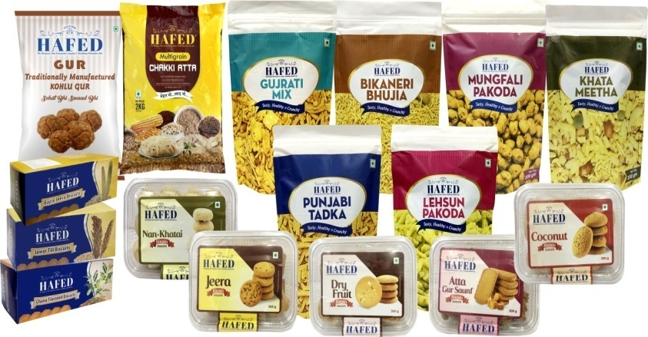
EXPORTS AND MARKETING
Exports : Export order of 20,000 MT Basmati Rice valuing 21.85 Million USD has been received from Saudi Arabia - 1st of its kind initiative.
Commercial Purchases : 1st time procured 32,000 MT Basmati Paddy during 2021-22 and 1.90 Lakh MT Wheat during 2022-23 on commercial basis at market price for export purpose.
Consumer Products : Launched Multigrain Atta, Namkeen, Biscuits, Jaggery, Poha, besides the earlier products like Rice, Edible Oils, Whole Wheat Chakki Atta, Sugar, Dalia in HAFED’s product range.

Slide 5

HARYANA SUGARFED HIGHLIGHTS/ ACHIEVEMENTS
Haryana has been paying the highest ever Sugarcane Price of Rs.362/- per quintal in the Country.
All the Co-operative Sugar Mills have cleared entire cane payment till crushing season 2021-22.
Over the past three years, the capacity has been increased from 25400 TCD to 30350 TCD i.e. by about 20%.
During last three years, plants of 3500 TCD at a cost of Rs.263 crore in Karnal, 5000 TCD at a cost of Rs.355 crore in Panipat have been commissioned.

Slide 6
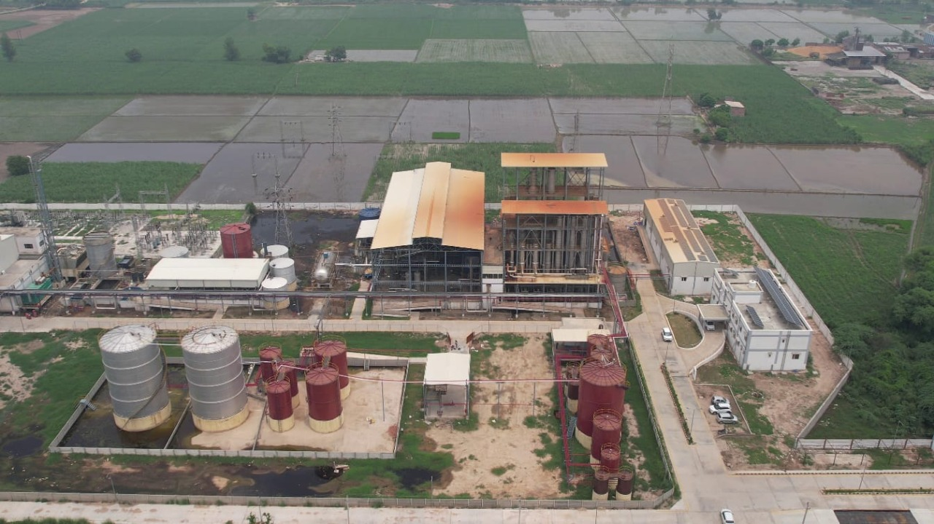
DIVERSIFICATION ACTIVITIES
Ethanol Plants
60 KLPD Ethanol Plant has been set up in Shahabad Cooperative Sugar Mills at a cost of Rs.99 crores
90 KLPD Ethanol Plant has been proposed to be set up in Panipat Cooperative Sugar Mills at estimated cost of Rs.150 crores.
Shahabad Ethanol Plant

Slide 7

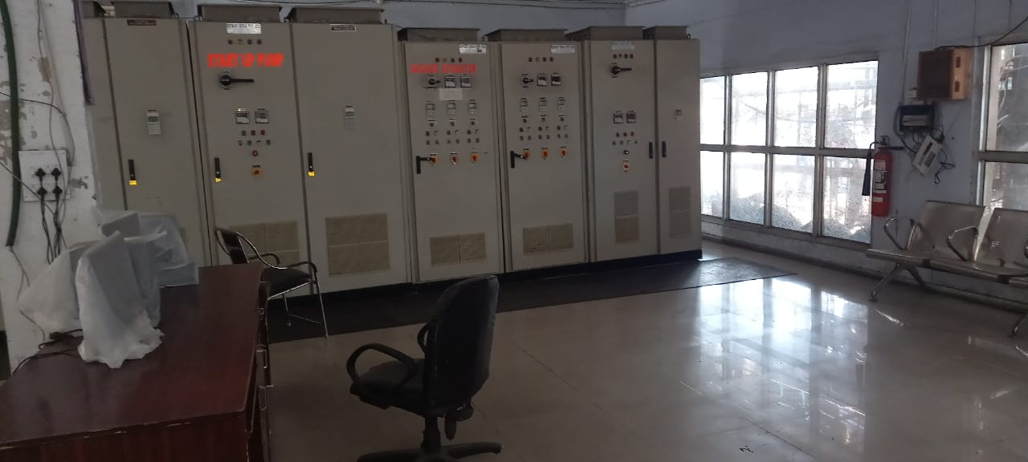
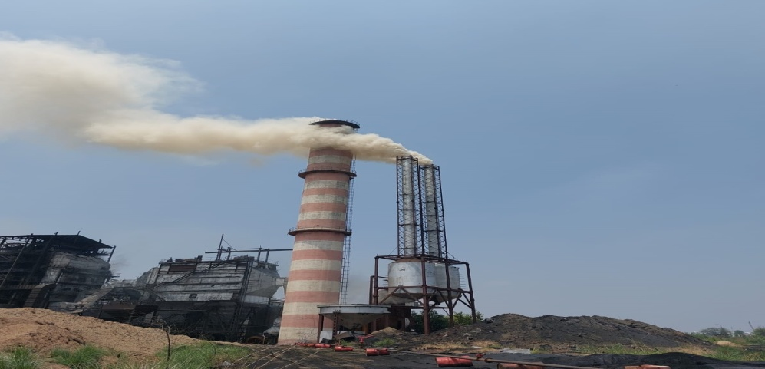
POWER CO-GENERATION PLANTS
24 MW Co-generation Plant set up in 2009-10 at a cost of about Rs.94 crores is in operation in Shahabad Cooperative Sugar Mills
16 MW Co-generation Plant set up in 2009-10 at a cost of Rs.40 crores is in operation in Rohtak Cooperative Sugar Mills
18 MW Co-generation Plant in Karnal and 28 MW in Panipat Cooperative Sugar Mills have also been set up
Shahabad Power Control Room
Rohtak Cogen Plant

Slide 8

DAIRYFED
Financials :
Three fold increase in profit. Total Profit jumped from INR 11.5 Cr in 2019-20 to 35.1 Cr in 2021-22
Total Turnover increase from INR1159 Cr in 2019-20 to INR 1505 Cr in Year 2021-22
Farmer’s Welfare : Subsidy of Rs 5 per liter is provided under Mukhya Mantri Dugdh Utpadak Protsahan Yojna to registered dairy farmers in lean season. INR 35.80 Cr distributed under this scheme during 2021-22.
Infrastructure:
Setting up of Aseptic Packaging Plant at Rohtak.
Setting up of Modern Milk Plant in Southern Haryana with a Capacity of 3 LLPD( Lac Liter per day)

Slide 9

HARCO BANK
KEY FUNCTIONS/PERFORMANCE OF
SHORT TERM COOPERATIVE CREDIT STRUCTURE(STCCS)
Crop loan is being disbursed through KCC @ 0% to Farmers. The interest subvention is being provided to prompt payee Farmers @4% by Govt. of Haryana in addition to 3 % of Govt. of India.
Crop Loan of Rs. 12000 crore disbursed to 12 lakh members of PACS during the year 2021-22..

Slide 10
NEW INITIATIVE IN PACS
Banking Operation in 307 PACS integrated Online with DCCB’s and all 751 PACS will be integrated by November 2022.
41 PACS have been identified under Agriculture Infrastructure Fund (AIF) scheme.

Slide 11
ONE TIME SETTLEMENT SCHEME FOR PACS
3 lakhs farmers have become regular payee members after availing the benefit of the OTS Scheme.
Principal Amount of Rs. 1200.00 crore recovered and overdue interest of Rs. 1500.00 crore waived off under the scheme.

