Slide 1
COOPERATIVE SOCIETIES UT LADAKH
Department of Cooperatives, UT Ladakh.

Slide 2
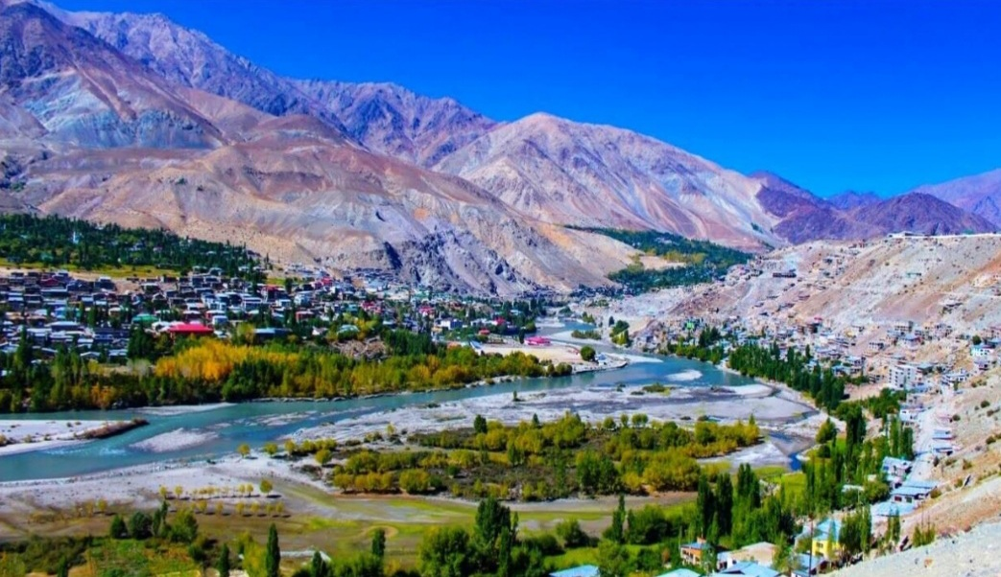
Ladakh
Ladakh - The region, owing to its extreme climatic conditions and topography has not witnessed the similar intensity of development as the other states and regions of the country. However, this have changed after the formation of Union Territory.
Geographic location
The Northern-most union territory of India, shares its international border with China, Pakistan and Afghanistan. It lies in the Greater-Himalayan ranges with salt and freshwater lakes and sand dunes. Indus, Zanskar, and Shyok are the major rivers that flow through the UT. An extremely thinly populated UT, Ladakh has a density of only 5 persons per sq. km.
The newly formed union territory after the Jammu & Kashmir State was bifurcated in October 2019, is at the crossroads of economy and development.

Slide 3
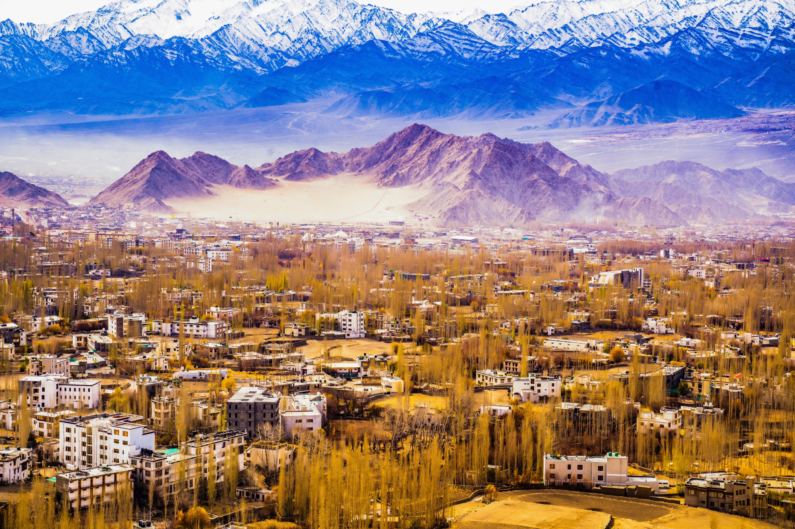
Cooperative movement in Ladakh
This remains to be a priority sector in UT Ladakh
In view of the efficiency of the cooperative movement as an effect agency for socio- economic transformation of the society cooperative institution have been termed as institution of economic emancipation.
Despite the peculiar topographic of Ladakh, difficult terrain and hostile climatic conditions, the cooperative movement in this mountain region has played a vital role in service of their member in particular and people in general.

Slide 4
Agenda Points
A. Policy Matters
(1) National Cooperation Policy: A national level committee for drafting national cooperative policy document has been announced recently. The department will share comments as soon as draft policy is circulated to UT-Ladakh.
(2) National Cooperative Database: The data regarding UT Ladakh stands submitted to NCDC (The detail is given at the last page)
B. New Proposed Schemes
(1) PACS in every Panchayat: Almost every panchayat in Ladakh has a PACS . A total of 159 PACS are registered 193 Panchayats.
(2) Export of Agro-based and other products: Last year Apricot was exported to Dubai and middle east countries and this year it increased to 35 MT and also sent to Singapore, Vietnam and Mauritius on trial basis. Mainly agro-based products are vegetables and fruits some of which are mainly unique Ladakh like apricot, Seabuckthorn, Broccoli, lettuce, peas etc. The local vegetable produce is majorly procured in bulk by marketing cooperative societies and supplied to army units on a negotiated contract basis every year.

Slide 5
Agenda Points
( (3) Promotion and Marketing of Organic Products: Ladakh is switching over to organic farming and has significantly reduced the procurement and distribution of chemical fertilizers quantities of which are being reduced. From last 2 years organic fertilizers like vermi-compost and local manure are provided to farmers on 80% subsidy to promote organic farming.
(4) Expansion of Co-operatives to New Areas: Farmers/consumer awareness cum sensitization programs are being held in both the districts for promotion of cooperative institutions as a means for collective and economic development of the farmers. Education and training including mainstreaming of cooperatives are being carried out. Adopting best practices of nearby Himachal Pradesh cooperatives are also on the card.

Slide 6
Agenda Points
(C) Subjects related to PACS and Model Bye-Laws
(1) PACS Computerization: Computerization of PACS is needed and the national policy for computerization of PACS will certainly help PACS in Ladakh to bring them on digital platform.
(2) Action Plan for Revitalization of defunct PACS: The main reason behind dysfunctional PACS is due to non-availability of sufficient working capital to meet the day-to-day expenses. The department has initiated to revive few societies by providing managerial subsidy under Subsidy schemes which seems not sustainable unless they have a fixed funds as revolving fund for bulk purchase and stocking of essentials for winter
(3) Model Bye-Laws of PACS: Comments stands submitted.

Slide 7
Agenda Points
(C) Subjects related to PACS and Model Bye-Laws
(4) Bringing Uniformity in State Cooperative Laws: The UT administration has presently two Acts -The Jammu and Kashmir Cooperative Society Act of 1989 and the J&K Self Reliant Act 1999.,
Those registered under Act of 1989(minimum of 50 members required for registration )are supervised ,audited and can avail financial assistance from Govt and are called Cooperative societies. On the other hand those registered under Act of 1999 (minimum of10 members required) are self-reliant cooperatives only. Though they are self-reliant but can receive Assistance/funding from the government after signing an MOU with the Government

Slide 8
Agenda Points
((D) Primary Co-operative Societies
(1) Prioritize Long Term Financing: long term Financing of Cooperative institutions will be a great step for economic development of the farmers. Provision of a revolving fund to the consumer cooperative societies dealing with bulk procurement and distribution of consumer goods on fair price and marketing societies dealing with bulk procurement of fertilizers etc
(2) Milk Co-operative Societies: Dairy is one of the emerging sectors in Ladakh and has a promising market. The UT administration has installed and commissioned a 2000 liters/hr capacity Milk pasteurization plant recently which will further augment the timely processing of the milk. A total 75 numbers of Dairy cooperative societies have been registered in UT-Ladakh with their Apex body in the form of UT- Ladakh Dairy Cooperative Federation Ltd.
(3) Fish Cooperative Societies: Ladakh has also a good potential of fish products it has some promising areas for aquaculture around the rivers and streams. The UT Administration has established several rainbow trout farms. Recently one Cooperative Society has been registered under fisheries and we expect many more such cooperatives in this sector.

Slide 9
Acts and Rules
The UT administration has presently two Acts on Cooperative concurrently in operation:
The Cooperative Society Act of 1989 which envisages Government participation in the share capital of the cooperative institutions besides casts certain statutory responsibilities to the Registrar of Cooperative Societies like audit, inspections, inquiries etc. 251 Cooperatives are registered under this act.
Under the J&K Self Reliant Act 1999 there are no such provisions where by Government share Capital can be mobilized, however the Cooperative can avail financial Assistants/funding from the government after signing an MOU with the Government. The Act guarantees maximum financial autonomy to the cooperative registered under this Act. Total of 176 Cooperatives are registered till date under this act. Since the formation of UT Ladakh as many as 108 new cooperatives have been registered.

Slide 10
Main Objectives of cooperative societies in UT Ladakh are as follows
To ensure availability of essential commodities through network of district / blocks and village level cooperative a
To market farmer produces through cooperative Marketing Societies
To procure, de-hair and arrange marketing of local pashmina wool and finished products like shawls sweaters and hosiery items
To procure process and provide marketing of sea buck throne, Apricots and other vegetables
To generate income to the local transporters
To ensure availability of bio-fertilizer and vermi-composting to the farmers

Slide 11
Major activities
Major activities of Cooperative Department , in UT Ladakh

Slide 12
Major activities of Cooperative Department , in UT Ladakh
Supply and distribution of essential items of daily use at fair price
Marketing of local agricultural, horticultural and livestock produce through various Cooperative societies:
One of the important mandate of Cooperative department is to provide various essential items of daily use to the consumers on fair price through various consumer cooperative societies across the region and has been playing an important role in price control and availability. Moreover, Cooperative Department ensures sufficient stocking of essential goods for winter months when Ladakh remains cutoff from rest of the country for 4-6 months. The UT administration has already made one Super Bazaar functional at Kargil and two more will be established one each at Sankoo and Diskit. Besides, 13 smaller consumer retail shops are coming up at 13 villages across Ladakh.
Marketing cooperative societies in both the districts have been providing platform for marketing of various agri-horticultural produce of local farmers such as vegetables, fruits, Seabuckthorn and livestock products like milk, cheese and other allied products. The supply is mainly to Army formations for which Cooperative societies gets a negotiable contracts facility.

Slide 13
Major activities of Cooperative Department , in UT Ladakh
Purchase and distribution of fertilizers like chemical and organic manure in the form of compost and local rigpa
Providing fresh vegetables to residents of Leh&Kargil;
The Cooperative Departments provides fresh vegetables in winter months when Ladakh remains cut off from the rest of the country. Last winter about 200 Mt s of vegetable and fruits were distributed. This will continue this winter also with enhanced tonnage
The cooperative department through Cooperative marketing societies purchases and distributes chemical fertilizers to the farmers of Ladakh region through license holders societies. As a step towards making Ladakh an organic state the department has been reducing the overall quantity of chemical fertilizers which is being replaced proportionally with organic manure likevermi-compost, rigpa(local manure)and being provided to farmers on 80% subsidy under Special Development Package to shift towards organic production.

Slide 14
Major activities of Cooperative Department , in UT Ladakh
REGISTRATION
Registration of Cooperative Societies under J & K Cooperative Act,1989 and Cooperatives under Act of 1999:
Number of Societies Registered
An important task of Cooperative department is to register new Cooperative Societies under J& K cooperative Act,1989 and under Act of 1999 respectively. Currently, only dairy, poultry and hatchery cooperative societies are registered under act of 1989 whereas all other sectors are registered under Self Reliant Cooperative Act,1999.Pertinent to mention here is that the J & K Cooperative Acts are not repealed post reorganization.The department conducts regular audit of the societies and timely elections are also conducted.
At present there are 427 Cooperative societies registered in both the districts of Ladakh

Slide 15
Success Stories
Successful Cooperative Societies;

Slide 16
Success Cooperative Case studies:
All Changthang Pashmina Grower’s Cooperative Marketing Society, Leh
The society was set up in early 80’s comprising of members who characteristically are nomads all around the year. The society has 19 multipurpose cooperative Societies as its members. Working of the society and its affiliates is to rear sheep, goats and yaks and obtain raw pashmina wool from them. The de-haring plant has been set up at Leh two decades back and now a new de-hairing plant is being procured which will start functioning this year. The de-hairing plant is funded by Ministry of Textiles, GOI.
BamiDuniya Cooperative Consumer store Leh
Bamiduniya In Persian means the roof of the world. This Cooperative Society was registered in the year 1958.It is a federation of 46 cooperative Societies and is run by an elected managing committee. The store is the distributor of Gujarat Cooperative Milk Marketing federation ltd., Mother Dairy, Food Processing Ltd., Siemens, Vegetables seeds India Ltd, Philips India Ltd. For institutional sale of Compact Florescent Lamps (CFL).In the past the Society was awarded National Cooperative excellence Award.
Fruit Growers’ Cooperative Marketing & Processing Society, Kargil
This Cooperative society has established the fruit processing facility at Kharu and their main expertise is in processing of Apricot products. The society consists of 167 members and stands registered in 1979. The UT Administration has provided the society with the fresh apricot canning plant and has helped in their packaging and branding. The members of the society are from the nearby villages where the best variety of Apricot called “Halman” is grown.The main produce of the society are Jams, Apricot oil, dry apricot and juices.

Slide 17
Looms of Ladakh Women Cooperative
Ladakh Transport Cooperative Society Ltd.
Ladakh Transport Cooperative Society, Leh was registered in the year 1989 under the J&K Cooperative Act of 1989. The cooperative has active members having a fleet of 1192 trucks and tippers. It mostly caters to the services of Indian Army besides local transportation needs. The cooperative alos spends money on charitable services from the profit
Looms of Ladakh Women Cooperative aims to bring together unemployed women artisan’s from remote villages of Ladakh. The women are trained in knitting and woven products. The raw material is sourced locally from nomads and livestock rearing communities of Ladakh who are the exclusive source of world famous Pashmina, Yak wool and sheep wool. The Cooperative consists of an all-woman team of 150—including office bearers, cashiers, product officers and event coordinators—steers the operation, which has clocked a profit of `75 lakh till date. A stable income means that the women have access to healthcare and personal care, money to feed and school their children, and greater self-esteem. Fifty per cent of the profits are taken home by the weavers, while the rest is reinvested into the co-op to acquire raw materials, inventories, upgrade skills and pay salaries.

Slide 18
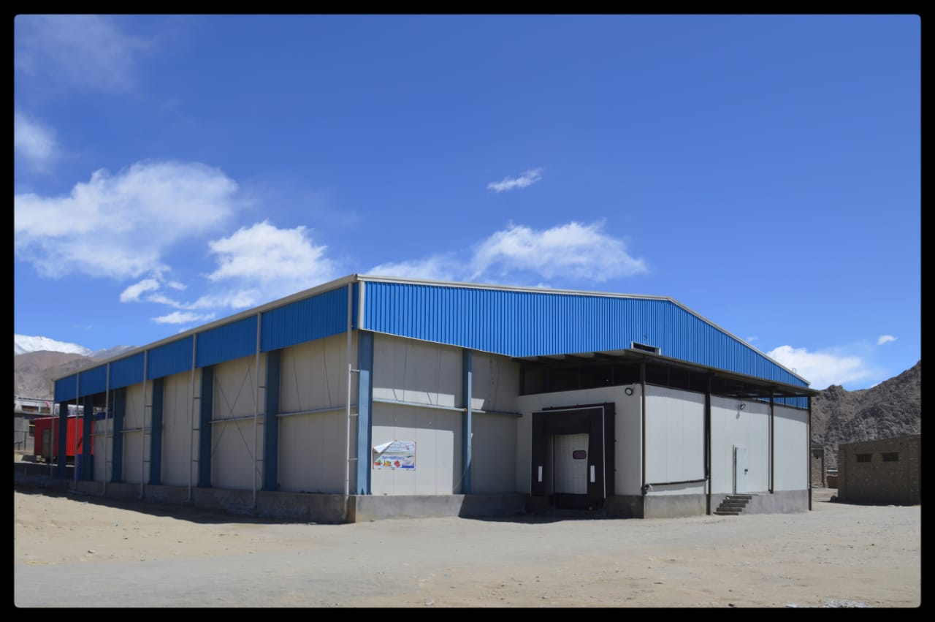
Special Projects-
1. Cold Storage
The Cooperative Department has created 1000MT Cold storage facility in Leh at a cost of Rs.11.67 crores under various schemes and is being presently efficiently manages by the department. The facility is being utilized by various entrepreneurs, local farmers and cooperative societies for storing of various consumer items like dairy products, chicken, frozen items and vegetables. The departments is also reviving the traditional storage facilities in villages. A Cold storage of 200MT is being constructed at Kargil this year.

Slide 19
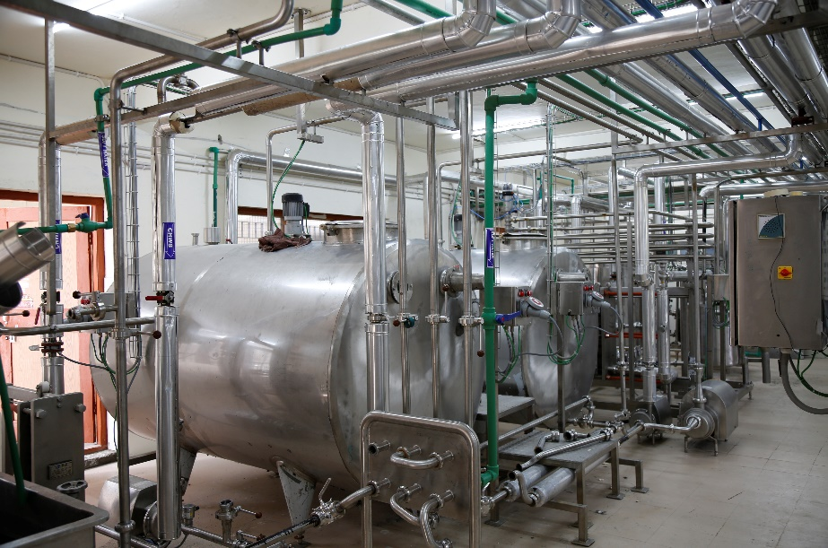
2. Milk Pasteurization plant
Department of Cooperative under Special Development Package has purchased all machineries and related items for the Milk Pasteurization plant. Subsequently, Ladakh Milk Federation, an Apex body of all Diary Cooperative Societies of Ladakh will procure milk from farmers and market the pasteurized milk mainly to army regiments and in the local market.
The apex federation is being registered with the National Cooperative Dairy Federation. An MOU has been signed with the National Dairy Development Board (NDDB) for running the Milk pasteurization plant for the first five years and will be handed over to Dairy Cooperative Society of Ladakh.

Slide 20
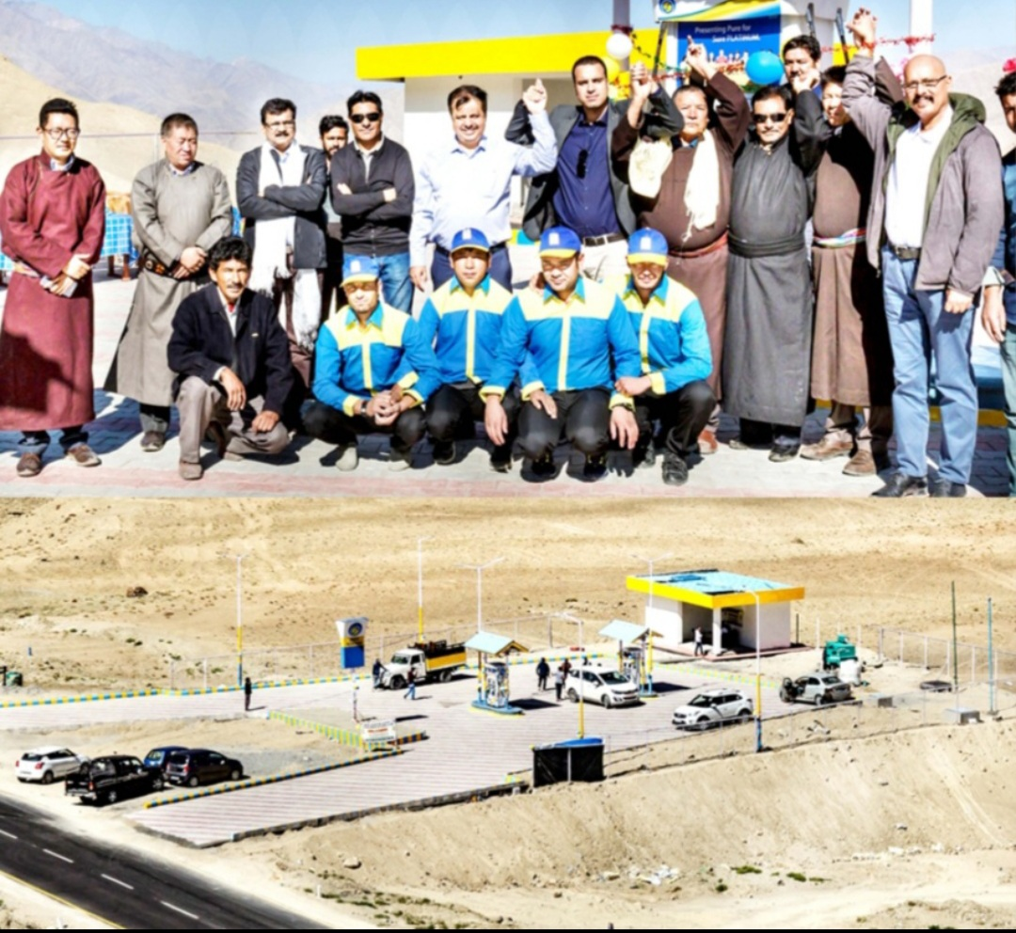
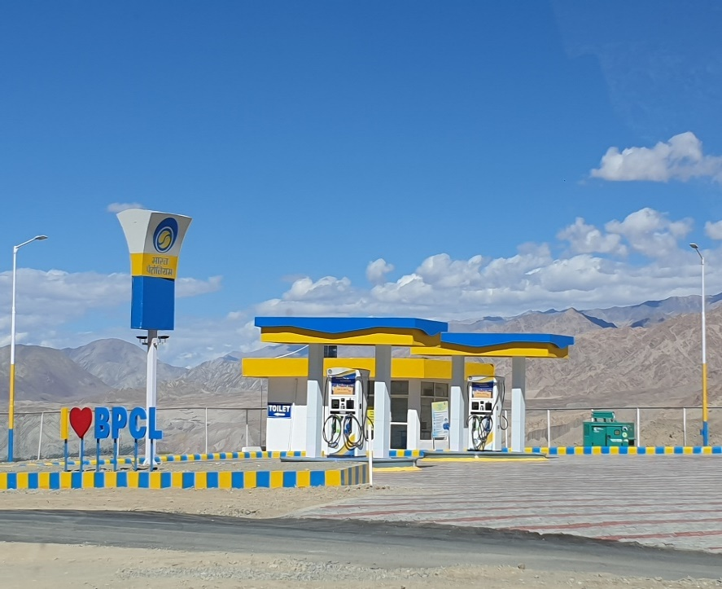
3. Filling Station
In order to venture into new business for the cooperative the Bhami -Duniya Cooperative society has begged the frenchisie
Of Bharat Petroleum Filling station at Nimoo.

Slide 21

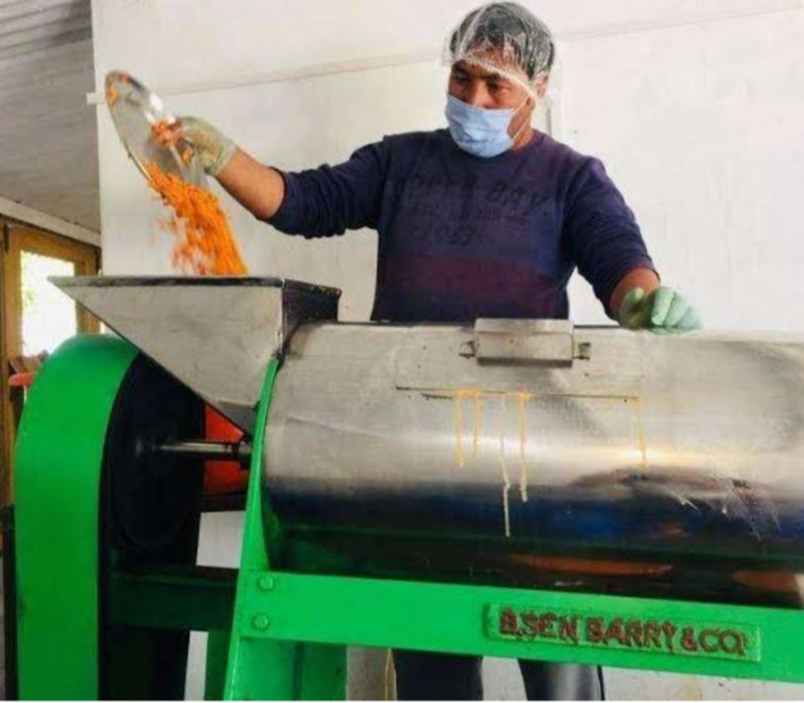
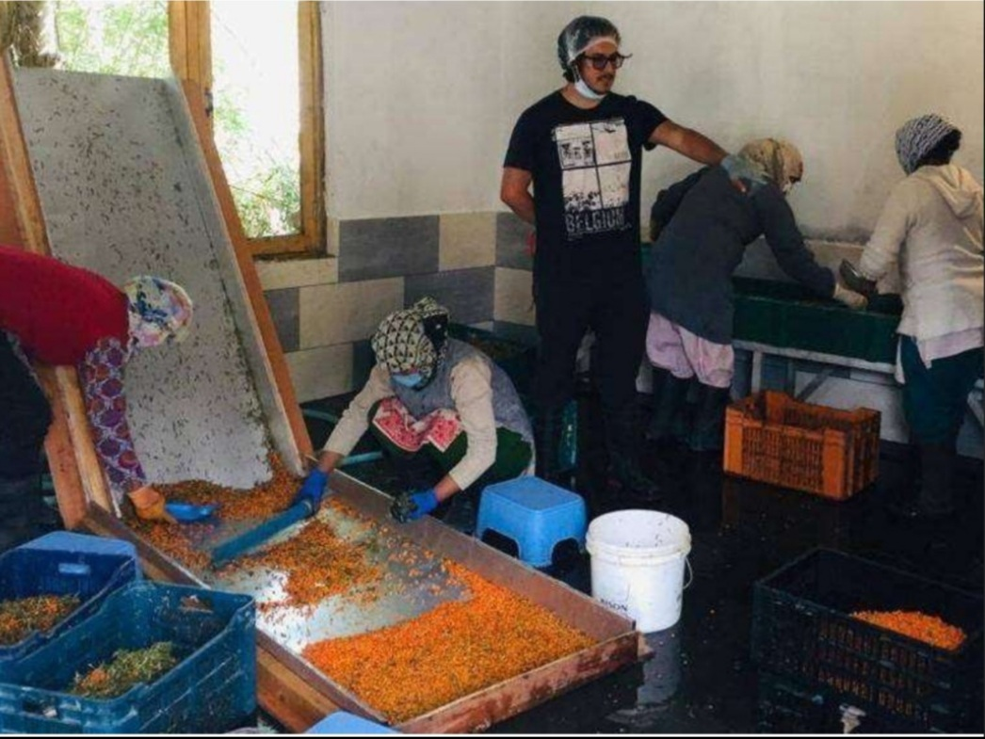
4. Seabuckthorn Leh berry processing
The cooperative was the first organization to realize the potential of Seabuckthorn Leh berry in Ladakh. Every year it collects berry and sells the pulp to national and international buyers. Last year it sold 550 barrels of pulps. However no value addition of the product beyond pulping has taken place. This year the cooperative will be selling Seabuckthorn squash under the brand name of “Golden Berry”.

Slide 22
National Cooperative Data base- UT Ladakh
S. No | Type of Cooperative Societies | Number
 | Primary Agri.Credit Societies (PACS) | 159
2. | Cooperative Marketing Societies | 10
3 | Handicraft Societies | 1
4. | Milk Societies | 75
5. | Transport Cooperative Societies | 2
6. | District Consumer Store | 10
7. | B1lock Level Consumer store | 4
8. | Whole sale Cooperative Store | 2
9. | Meat Dealer Society | 2
10. | Poultry Cooperative Society | 2
11. | Govt. Employees Credit Society | 1
12. | Housing Cooperative Society | 1
13. | Labour Cooperative Society | 2
14. | Self-Reliant Cooperative | 156
 | Total | 427

Slide 23
Major Issues of Ladakh Cooperative Sector
Training and Capacity Building.
Provision of exposure tour of departmental officials and society members outside Ladakh.
Revolving fund /Working capital shortage.
Huge interest rates on bank loans availed by societies which significantly affects them economically.
Market linkage for organically grown local products outside the UT.
Extension of Centrally Sponsored Schemes to Ladakh.
Establishment of a Cooperative Management Institute in Ladakh.

Slide 24
Thank You

